Slide 1


15 Things I Wish I'd Learned in Law School
Jordan Turk
Attorney & Director of Education, Smokeball

Slide 2



Jordan L. Turk
Director of Education & Attorney
Development, Smokeball
JD, University of Arkansas School of Law
BA, The University of Texas at Austin
Practicing Family Law Attorney in Texas
Host, Hacking Law Firm Success

Slide 3
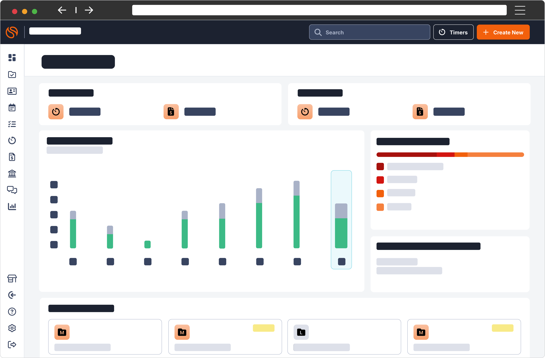
The #1
AI-Powered Platform
to Run Your Best Firm
One platform to boost productivity
Beautiful client experiences with
seamless intake
Enhance your output with the
power of AI
Automated billing that values
your work
Analytics and reporting to drive
your growth

Slide 4

INTRODUCTION
Consider This Your Opportunity to Commiserate
Law school taught you doctrine, theory, and how to think like a lawyer. But the day-to-day realities of practicing litigation? Those lessons come later, often through trial and error.
This presentation is your chance to connect with colleagues across the country and around the world who've experienced the same surprises, frustrations, and breakthroughs. We're pulling back the curtain on what really happens in practice.
Remember: the wisest person is the one who knows that they know nothing. Stay humble, stay curious, and keep learning.

Slide 5
LESSON 1
Motion Practice Isn't Black and White
You might expect motion practice to be straightforward—research the law, draft your argument, file it. Reality check: judges are human beings dealing with overwhelming caseloads, and they appreciate lawyers who make their lives easier.
Lead With Your Ask
Write Tight
State what you want in the first paragraph. Don't bury it on page four.
Every sentence should earn its place. Cut the fluff.
You can make a motion for legitimately anything you need to, even to turn on a fax machine.
Judges don't want to decipher your ten-page motion when a three-page version would do. Respect their time, and they'll respect your arguments.
Use Headers and Graphics (Judiciously)
Make it scannable. Judges appreciate roadmaps through your argument.

Slide 6
LESSON 2
You Have to be a Bill Collector
Nobody warns you that a significant part of your job involves chasing down payments. It's awkward, uncomfortable, and absolutely necessary. Clients who don't pay can sink your firm, and your career prospects along with it.
Learning how to communicate about money professionally is a skill that takes practice. You need to be firm without being aggressive, persistent without being pushy, and clear about consequences without threatening.
01
02
Set Expectations Early
Invoice Promptly and Regularly
Discuss billing practices, payment schedules, and consequences during your initial consultation. Put everything in writing.
Don't wait months to send bills. Regular invoicing keeps clients aware of costs and prevents sticker shock.
03
04
Follow Up Systematically
Know When to Withdraw
Create a follow-up system: friendly reminder at 7 days, firmer notice at 15 days, final notice at 30 days.
If a client consistently refuses to pay, file a motion to withdraw. Protect yourself and your firm.

Slide 7

LESSON 3
Setting Boundaries Is Not Optional
Law practice is demanding, but it doesn't have to consume your entire existence. Without boundaries, you'll burn out fast, and resentful lawyers don't serve anyone well.
Your firm and your clients will take as much as you give. It's your responsibility to set limits on your availability and stick to them. This isn't about being lazy; it's about sustainable practice over the long haul.
Technology enables constant connectivity, which can be a blessing and a curse. You have the power to control when and how you engage with work communications.
Mute Outlook Notifications
Establish Phone-Free Hours
Use Delayed Send
Turn off pop-ups and sounds. Check email on your schedule, not every time a message arrives.
Don't check your work phone before 6 AM or after 10 PM. Emergencies can wait until morning.
Draft emails whenever inspiration strikes, but schedule them to send during business hours.

Slide 8

LESSON 4
Some Opposing Counsel (and Judges) Are Truly Atrocious
You'll encounter opposing counsel who are condescending, unprofessional, or outright hostile. You'll face judges who are biased, impatient, or shockingly ignorant of the law. This reality can be disillusioning, especially when someone calls you "little lady" in open court.
Experience does not equal intelligence, emotional or otherwise. Some lawyers have practiced for decades while learning nothing about professionalism. Some judges abuse their power in ways that genuinely ruin lives.
The Texas Lawyer's Creed reminds us that we can be civil even in adversarial situations. Mutual courtesy—like reasonable extensions on discovery—benefits everyone and reflects well on the profession.

Slide 9
What You Can Do About Bad Actors
Always Do Your Research
1
Google your potential client, the opposing party, and opposing counsel for every single case. You might discover that their bar license has been suspended and they shouldn't be practicing. Knowledge is power.
2
Document Everything
Keep detailed records of unprofessional conduct. If you need to file a grievance or report judicial misconduct, you'll have evidence.
3
Maintain Your Professionalism
Don't stoop to their level. Your reputation is your most valuable asset. Judges notice who remains composed under pressure.
4
Seek Support
Talk to senior colleagues about how to handle difficult situations. You're not alone, and others have navigated these waters before.
5
Know Your Options
In extreme cases, consider recusal motions, bar complaints, or even changing practice areas. Your mental health matters more than any case.

Slide 10
LESSON 5
The Law Can Be Forgiving
The legal profession has a reputation for being unforgiving, but there are safety nets you might not know about. Organizations like the Judges and Lawyers Assistance Program (JLAP) or the Texas Lawyers Assistance Program (TLAP) exist to help lawyers struggling with substance abuse, mental health issues, or burnout.
Combat Burnout Strategically
Schedule regular therapy or counseling sessions
Exercise consistently—even a 20-minute walk helps
Maintain hobbies completely unrelated to law
Leverage technology to automate repetitive tasks
Resist lifestyle creep—you don't need to keep up with the Joneses
Build a support network of colleagues who understand
These programs offer confidential support and resources. Reaching out for help is not a sign of weakness, it's a sign of wisdom. The profession is beginning to recognize that lawyer well-being directly impacts client service and justice itself.
Burnout is rampant in the legal field. The adversarial nature of the work, combined with long hours and high stakes, takes a toll. Self-care isn't a luxury; it's a professional necessity.

Slide 11
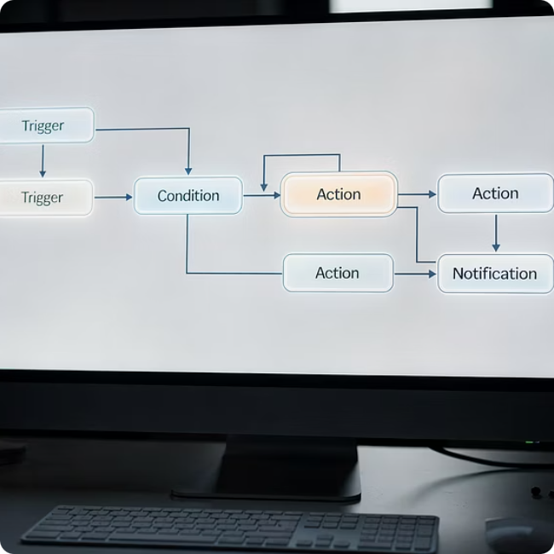
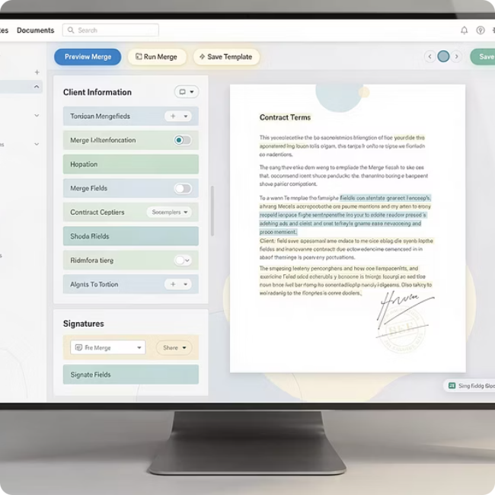

LESSON 6
Legal Technology Exists Beyond Lexis and Westlaw
Law school might have taught you how to research on Lexis and Westlaw (maybe), but that barely scratches the surface of legal technology. There's an entire ecosystem of tools designed to make your practice more efficient, accurate, and profitable.
The problem is, you don't know what you don't know. Document automation, workflow management systems, e-discovery platforms, practice management software—these tools can transform how you work, but nobody tells you they exist or how to use them.
Workflow Automation
Document Assembly
Practice Management
Automate routine tasks like engagement letters, discovery responses, and deadline calculations. Reclaim hours every week.
Create templates for repetitive documents. Change the details, not the entire structure every single time.
Track time, manage deadlines, organize client files, and generate invoices—all in one integrated system.
Take advantage of training resources. Most platforms offer free webinars, tutorials, and support. Invest time in learning these tools early in your career. The return on investment is enormous.

Slide 12
LESSON 7
Objections Are Terrifying (and Essential)
Ask any junior litigator what they find most intimidating about trial work, and objections will top the list. You can prepare in advance for authenticating evidence or arguing admissibility, but objections require you to think on your feet in real-time, while everyone watches.
Study the Rules
Watch Trials
Memorize your applicable Rules of Evidence. Have a cheat sheet of common objections.
Attend trials in your courthouse. Observe how experienced attorneys object.
There's no script. Opposing counsel makes a statement, you have seconds to determine if it's improper, formulate the correct objection, and state it clearly and confidently. All while the judge, (sometimes jury), and client stare at you.
Practice Out Loud
Enroll in Training
The good news? This skill improves dramatically with practice. Programs like trial institutes offer structured environments to practice objections repeatedly until they become second nature. You can also work on eliminating verbal fillers like "um" and "uh" that undermine your authority in the courtroom.
Role-play with colleagues. Get comfortable saying "Objection, hearsay" confidently and being able to explain why you objected.
Sign up for trial advocacy programs that focus on objection practice.

Slide 13



LESSON 8
Mentorship Is Crucial
No one succeeds in litigation alone. You need mentors—experienced attorneys who can guide you through challenging situations, review your work, and help you develop judgment that only comes with time.
Organizations like Inn of Court provide structured mentorship opportunities. These groups bring together lawyers at different career stages for monthly meetings focused on professionalism, ethics, and skill development. The connections you make can last a lifetime.
But mentorship is a two-way street. You can't just expect senior lawyers to invest in you without reciprocating. Foster those relationships actively. Send email updates on matters they helped you with. Thank them specifically for their guidance. Show them that their investment in you is paying off.
Find Mentors
Nurture Relationships
Pay It Forward
Join professional organizations. Volunteer for committees. Make yourself visible to senior attorneys.
Regular communication is key. Don't only reach out when you need something.
As you gain experience, mentor law students and newer attorneys. The profession thrives on this cycle.

Slide 14
LESSON 9
Your Client's Problems Are Not YOUR Problems
It's easy to get emotionally entangled with your clients. They're often going through the worst moments of their lives, and you want to help. But you need to maintain professional boundaries for your own sanity and effectiveness.
Observe Seasoned Attorneys
Sit in on client meetings, especially potential new client (PNC) consultations, with seasoned lawyers. Watch how experienced lawyers maintain empathy while setting boundaries.
Your client's divorce, bankruptcy, or criminal charges are their problems, problems you're helping them solve. These issues should not consume your emotional energy outside of work. This distinction is critical for avoiding burnout and maintaining perspective.
Document Skeptically
Also, never assume your client is an angel. Early-career lawyers sometimes become overly invested and defensive about their clients, only to discover later that their client withheld critical information or outright lied.
Verify your client's version of events. Ask probing questions. Get documentation for everything.
Maintain Perspective
Remind yourself daily: you're their advocate, not their therapist, friend, or family member.

Slide 15
LESSON 10
The Court Clerk Is the Most Powerful Person in the Courthouse
Judges have authority, but court clerks and coordinators control access and information. They manage schedules, handle filings, know the judge's preferences, and can make your life significantly easier, or harder.
Smart attorneys cultivate respectful relationships with court staff. Learn their names. Thank them for their help. Be patient when they're overwhelmed. These small courtesies will pay dividends when you need a favor or critical information.
This principle applies equally to support staff at your own firm. Paralegals and assistants are the backbone of every successful law practice. Attorneys who are shocked when they can't keep staff should look in the mirror—the call is coming from inside the house.
People generally don't quit bad jobs; they quit bad managers. If you end up having people report to you, you HAVE TO work on becoming a good boss. Leadership skills aren't innate, they're learned, and they're essential for building a sustainable practice.

Slide 16
LESSON 11
Don't Mess Around With Your Trust Account
This Is Not Negotiable
Your client trust account holds money that doesn't belong to you. Every state has strict rules about how these funds must be handled, and violations can result in disbarment—permanently.
Trust account violations are among the most serious ethical breaches an attorney can commit. They will end your career.
One of my law school classmates is now a convicted felon because of trust account violations. This isn't hypothetical. It happens.
If you're unsure about trust account rules, consult your state bar's ethics hotline. Take CLE courses on trust accounting. Use practice management software with built-in trust accounting features that help prevent mistakes. The stakes are simply too high to be careless.
Your reputation takes years to build and seconds to destroy. Trust account violations will destroy it faster than anything else.

Slide 17
LESSON 12
Master Boolean Search Terms for Legal Research
Effective legal research is a superpower that distinguishes great lawyers from mediocre ones. But most law students graduate without understanding how to construct sophisticated Boolean searches on Westlaw or Lexis.
Boolean operators (AND, OR, NOT, proximity connectors) allow you to pinpoint exactly what you need instead of drowning in irrelevant results. Learning these techniques will save you countless hours and help you find authorities your opponents miss.
Here's a secret: both Westlaw and Lexis offer unlimited live support while in law school (and beyond, depending on your subscription). If you're not finding what you need, call or chat them. Have support walk you through their search strategy, explaining which Boolean terms they're using and why. This is free training from experts—take advantage of it.
01
02
Learn the Operators
Use Live Support
Study Boolean logic: AND (both terms), OR (either term), NOT (exclude terms), and proximity connectors like /s (same sentence) or /p (same paragraph), "", etc.
Contact Westlaw or Lexis support when you're stuck. Ask them to explain their search methodology step-by-step.
03
04
Practice Regularly
Save Your Best Searches
The more you search, the better you'll get. Experiment with different search strategies and compare results.
Both platforms let you save searches. Build a library of effective queries for common issues in your practice area.

Slide 18

LESSON 13
You Don't Need to Stay at One Firm
Many young lawyers feel trapped at their first firm, believing that leaving looks bad on their resume or signals disloyalty. This mindset keeps talented attorneys in toxic environments where they're underpaid, overworked, or simply unhappy.
Here's the truth: lateral moves are completely normal in the legal profession. Attorneys move between firms regularly for better opportunities, higher compensation, more interesting work, or improved quality of life. None of this reflects poorly on you.
Always take the call. Explore your options. Even if you're not ready to move, these conversations provide valuable market intelligence about what you're worth and what opportunities exist.
Network Continuously
Consider Legal Tech
Don't Stay Out of Fear
Maintain relationships with colleagues at other firms, recruiters, and law school classmates. Your next opportunity often comes through personal connections.
If you're wanting to pivot out of traditional law firm life, explore careers in legal technology. Companies want people who understand legal practice.
Loyalty to a firm that doesn't value you is misplaced. Your career belongs to you, not your employer.

Slide 19
LESSON 14
Confirm Everything in Writing. Always.
Memories fade. People forget conversations. Misunderstandings happen. Clients deny agreeing to things. Opposing counsel conveniently forgets promises made during conference calls. No one can remember what the Judge actually said during their rendition.
The solution is simple but requires discipline: confirm everything important in writing. Every. Single. Time.
This applies to client communications, agreements with opposing counsel, instructions from supervising attorneys, and court rulings. A brief email confirming your understanding provides proof and prevents disputes later.
With Clients
With Opposing Counsel
"Per our phone conversation today, I understand you want to proceed with X strategy. I'll begin Y next week.
"This email confirms our agreement to extend the discovery deadline to [date]. I'll prepare the agreed order for your review."
With Supervising Attorneys
During Court Renditions
"Following our meeting, I understand you want me to draft the motion for summary judgment by Friday and focus on the negligence claim first."
"Your Honor, may I have a moment to confirm the deadlines you just announced? I want to ensure I heard correctly..." Document immediately while you are still in the courtroom.
This practice protects you professionally and creates a clear record that prevents disputes. It takes an extra two minutes and can save you from career-threatening mistakes.

Slide 20
LESSON 15
Never Be the Third Attorney on a Case
Unless one of the prior attorneys is dead or incapacitated, being the third lawyer on a case is a massive red flag. Think about what it means: this client has already fired two attorneys. The problem is almost certainly the client, not the lawyers.
Ask About Prior Counsel
Trust Your Instincts
If something feels off during the consultation, it probably is. Don't ignore red flags.
During intake, ask directly: "Have you had other attorneys represent you in this matter? Why did you leave?"
These clients are often unreasonable, unrealistic about their case's value, unwilling to follow advice, or impossible to satisfy. They'll blame you for problems their previous attorneys created. They'll expect miracles. They'll fight you about bills. They'll leave negative reviews when you can't deliver impossible outcomes.
I know you need clients, especially early in your career. But some clients will cost you more—in time, money, stress, and reputation—than they're worth. Learn to recognize these warning signs and have the courage to decline representation.
Get Comfortable Firing Clients
Sometimes you need to withdraw from representation. Know the ethical rules and have a withdrawal template ready.

Slide 21
BONUS LESSON
No One Knows What They're Doing When They First Start
Here's the secret that every senior attorney knows but forget as we get experience: when we started practicing, we had no idea what we were doing either. We made mistakes. We felt overwhelmed. We questioned whether we were cut out for this profession.
The difference between attorneys who succeed and those who don't isn't raw talent or innate genius. It's persistence, humility, and willingness to learn from mistakes. Every skilled litigator you admire was once exactly where you are now—uncertain, nervous, and trying to figure it out.
Imposter syndrome is nearly universal among new attorneys. That feeling that you'll be exposed as a fraud? Almost everyone experiences it. The attorneys who seem confident? Many of them are faking it until they make it, just like you.
The goal isn't to know everything on day one. The goal is to become a little better every day, learn from every case, and develop judgment over time.
Give yourself permission to be a beginner. Ask questions. Admit when you don't know something. Seek help. Nobody expects perfection from junior associates—they expect effort, integrity, and continuous improvement. You'll get there. Trust the process.

Slide 22

Your Path Forward
Be patient with yourself
Building a successful practice takes years, not months. Focus on steady growth rather than overnight transformation.
Stay humble and curious
The wisest person knows they know nothing. Every case teaches something new. Remain open to learning throughout your career.
Build your support system
Cultivate mentors, join professional organizations, and maintain friendships with colleagues who understand the unique challenges of litigation practice.
Protect your well-being
Litigation is challenging, often frustrating, and occasionally heartbreaking. It's also intellectually stimulating, meaningful, and deeply rewarding when you help clients navigate their most difficult moments.
Set boundaries, maintain hobbies, exercise regularly, and don't hesitate to seek help when you're struggling. You can't serve clients effectively if you're burned out.
The lessons in this presentation—from mastering objections to managing trust accounts to recognizing toxic clients—will serve you throughout your career. Revisit them periodically as you gain experience. You'll find new meaning in each lesson as your practice evolves.
Welcome to the real world of law practice. You've got this.

Slide 23
The #1
AI-Powered Platform
to Run Your Best Firm
One platform to boost productivity
Beautiful client experiences with
seamless intake
Enhance your output with the
power of AI
Automated billing that values
your work
Analytics and reporting to drive
your growth

Slide 24
Would you like to learn more about how Smokeball can work for your firm?
If yes, one of our law firm specialists will follow up.
Yes
Not at this time
I'm already a Smokeball user

Slide 25
Questions?

Slide 26

RAFFLE
$150 Amazon Gift Card
Click on the link below and complete the entire form to qualify for a chance to win a $50 Amazon Gift Card.
https://www.surveymonkey.com/r/7PF22K8
150

Slide 27



Thanks for joining!
Jordan Turk
Attorney & Director of Education & Attorney Development at Smokeball
jordan.turk@smokeball.com

