Slide 1
Once Upon a Time in the Courtroom
Quentin Brogdon
Crain Brogdon, LLP
Dallas, Texas
214-598-1009 Cell
Qbrogdon@crainbrogdon.com

Slide 2
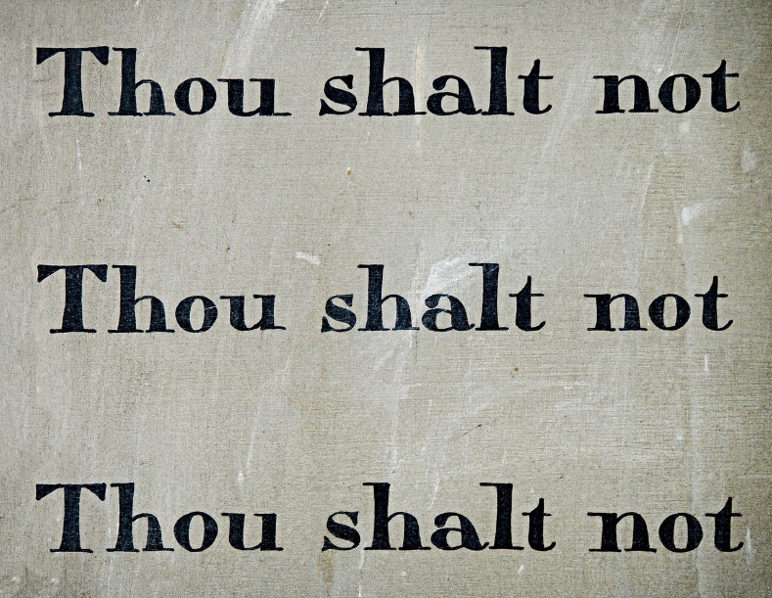

“Thou shalt not” v. “Once Upon a Time”

Slide 3

A Timeless Art

Slide 4
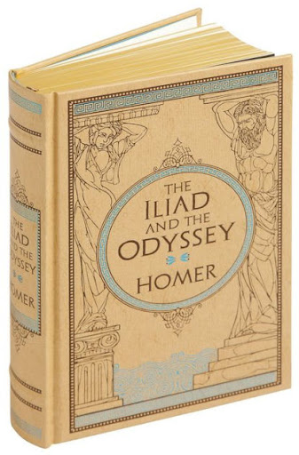
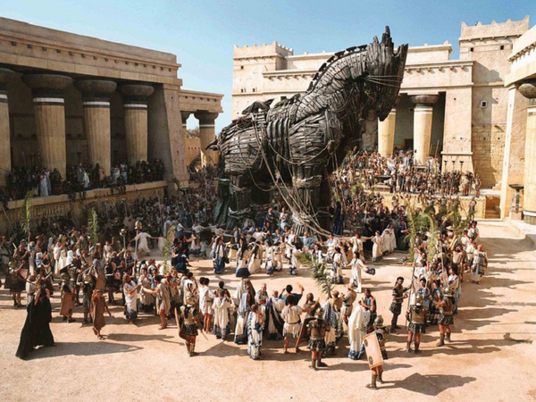
A Timeless Art

Slide 5



Our Religions

Slide 6
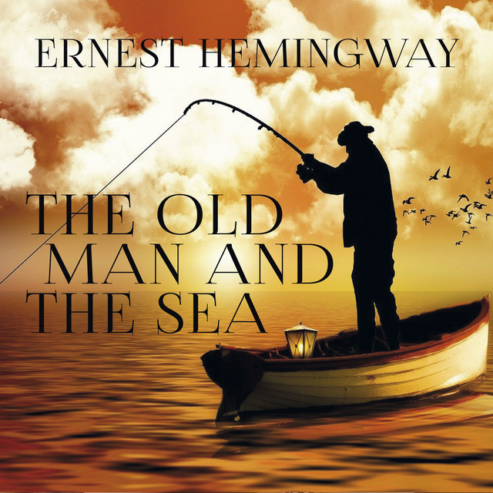
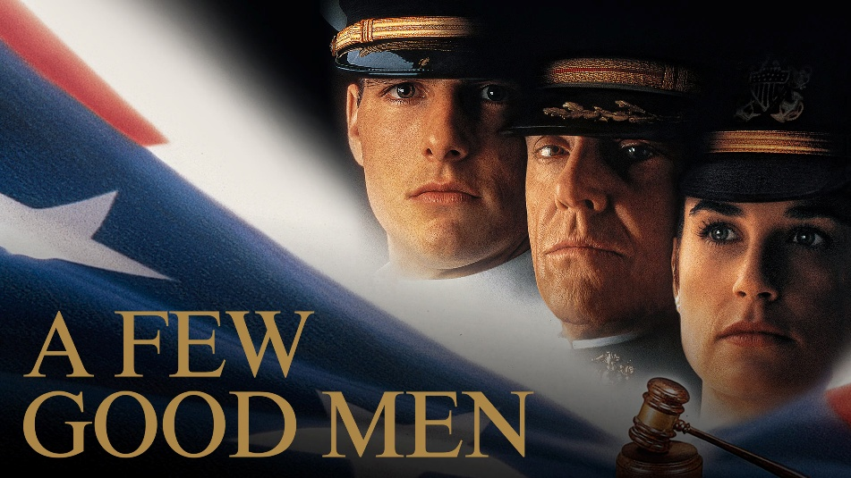
Great Literature & Hollywood

Slide 7
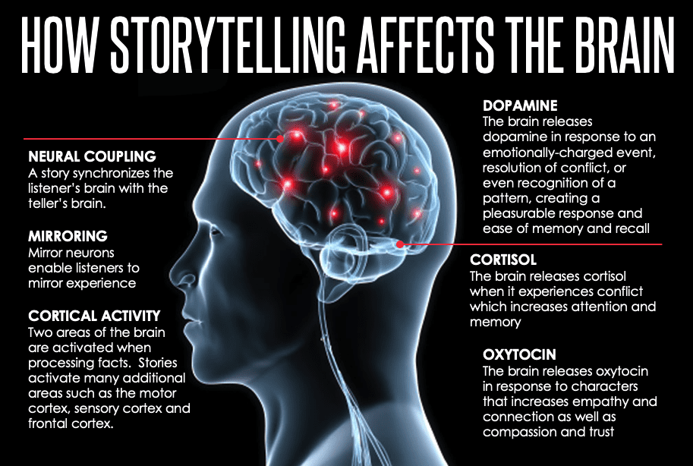

Slide 8
The Power of Stories in Court
1. Decisions: hearts and intuition
2. Decisions: flesh & blood actors.
3. Framework to process evidence.
4. Create order from chaos.

Slide 9


Slide 10
Themes
1. Universal truths.
2. Common sense.
3. Proverbs.
4. Timeless folk wisdom.

Slide 11
Themes
A trial “is the telling of a story that ensnares and then persuades six or twelve strangers to reach a conclusion and act in a particular way.”
Russ Herman, Courtroom Persuasion.

Slide 12
Themes
“This case is a story about a trucking company that put profits over safety, and the predictable, obvious, and preventable harm caused to an innocent driver by that decision.”

Slide 13
Developing Themes
1. Other lawyers.
2. Friends & relatives.
3. Spouses.
4. Focus groups (large and small)
5. The client (you must listen)

Slide 14
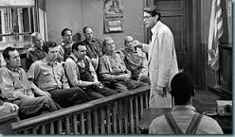
Why Tell Stories?

Slide 15
Goals
1. Establish case theme
2. Establish credibility
3. Establish connection
4. Why case matters in big picture
5. Framework to process
forthcoming evidence...

Slide 16
Goals
6. Persuade jurors within the rules.
7. Emphasize key evidence and
testimony.
8. Humanize client.
9. Plant "hooks" with questions.
10. Preemptively concede
weaknesses...

Slide 17
Goals
11. Anticipate defenses.
12. Empower jurors by motivating
them to take action.

Slide 18
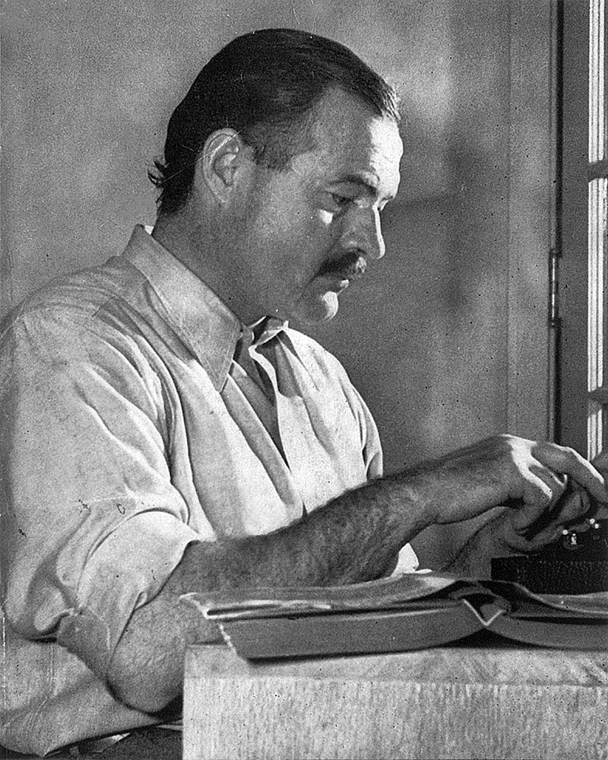
The Power of a Story

Slide 19
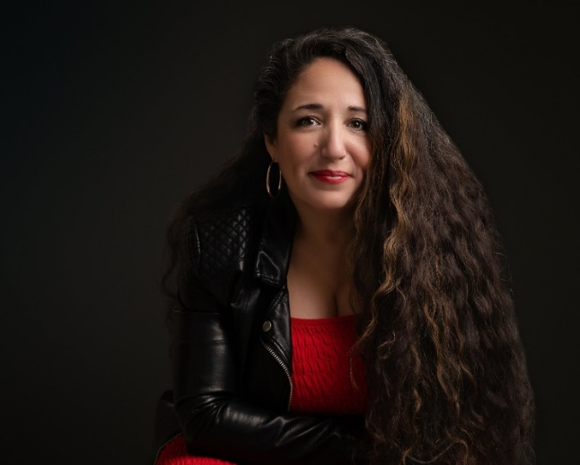
“We can choose to be a character in a story written by somebody else, or we can choose to be the author of our own story.”
Ruby Garcia

Slide 20
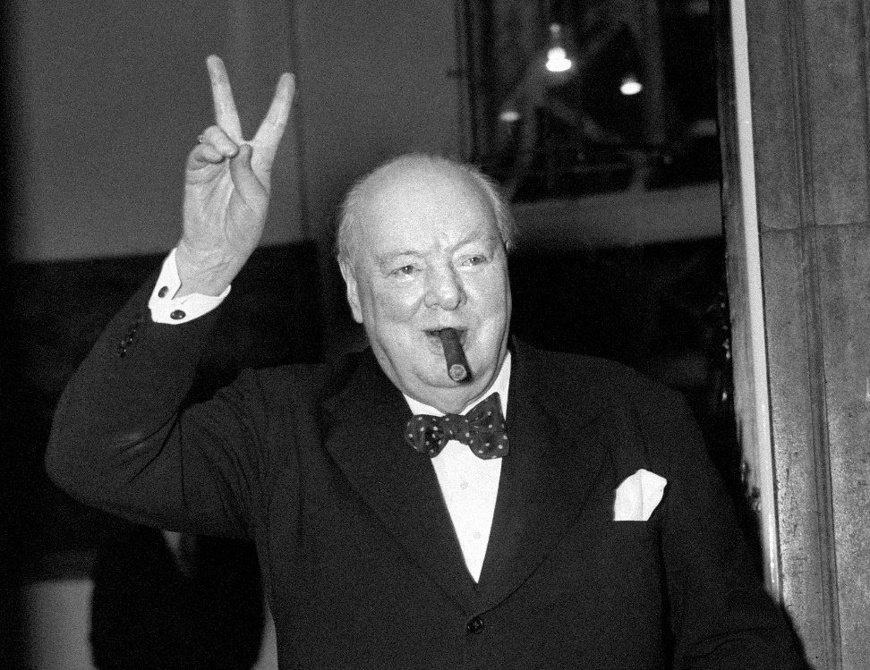
“History will be kind to me, for I intend to write it.”

Slide 21
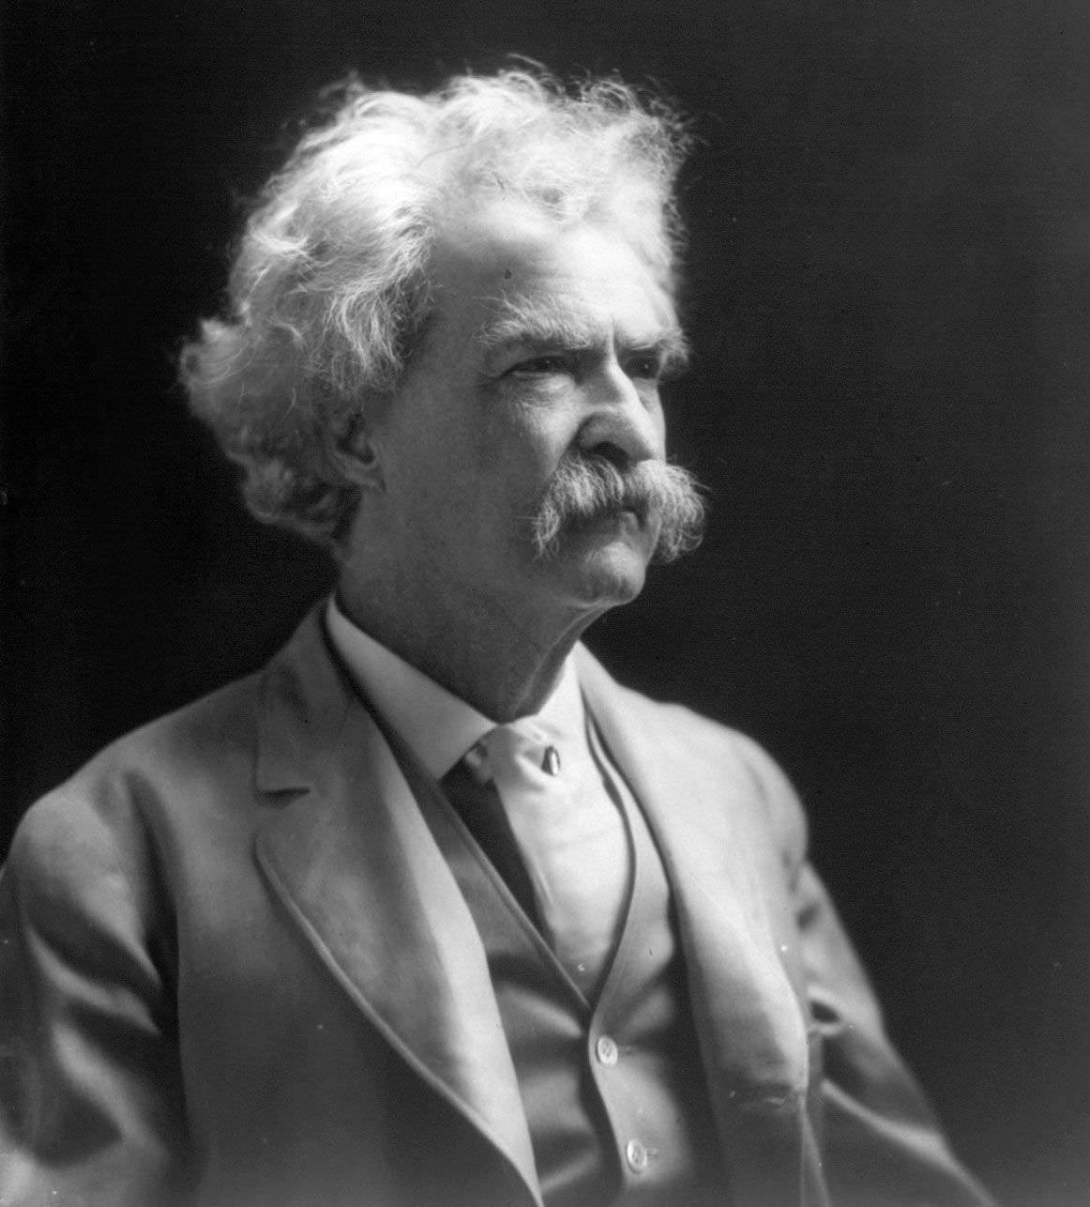
Mark Twain

Slide 22
Mark Twain on Stories
Never let the truth get in the way of a good story.
Truth is stranger than fiction, but it is because fiction is obliged to stick to the possibilities; truth isn’t.

Slide 23
Mark Twain on Stories
If you tell the truth, you don’t have to remember anything.
If you wish to lower yourself in a person’s favor, one good way is to tell his story over again, the way you heard it.

Slide 24

A Story in 6 Words
For sale:
baby shoes,
never worn.

Slide 25
“He was an old man who fished alone in a skiff in the Gulf Stream and he had gone eighty-four days now without taking a fish.”

Slide 26
The Old Man and the Sea

Slide 27
“When Augustus came out
on the porch, the blue pigs
were eating a rattlesnake –
not a very big one.”

Slide 28
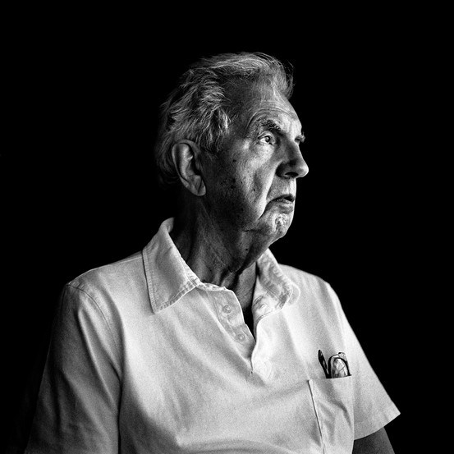
Larry McMurtry’s Lonesome Dove

Slide 29
“In my younger and more vulnerable years my father gave me some advice that I’ve been turning over in my mind ever since.”

Slide 30
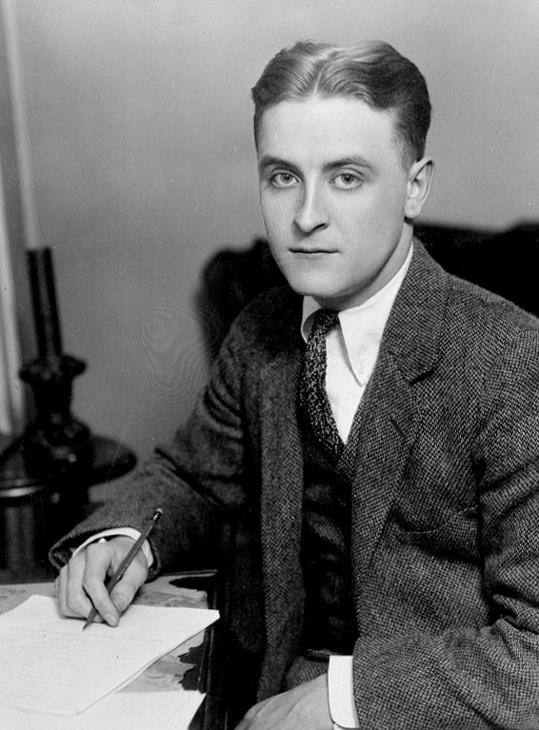
F. Scott Fitzgerald’s The Great Gatsby

Slide 31
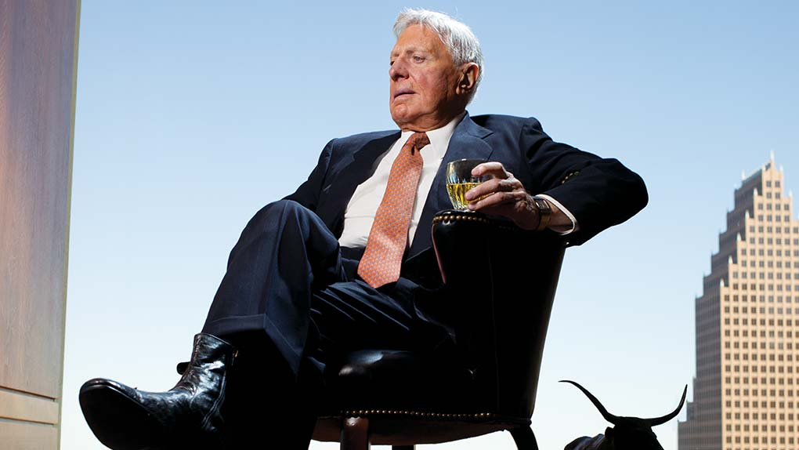
“Heroes and Villains”

Slide 32
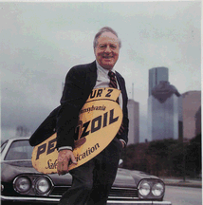
“Heroes and Villains”

Slide 33

“Heroes and Villains”

Slide 34

“Heroes and Villains”

Slide 35
When Do You Tell the Story?

Slide 36

Closing Arguments

Slide 37
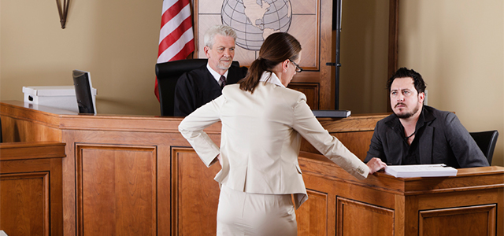
Direct Exams of Your Witnesses

Slide 38
Voir Dire

Slide 39
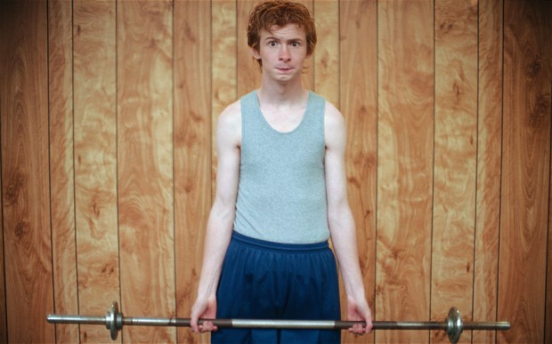
Opening Statements

Slide 40
How to Argue Without Arguing
1. Ask yourself …
2. Does it make more sense that X
occurred or that Y occurred?
3. Who had the best opportunity to
do X?
4. On the one hand, you’ll hear X,
but on the other hand, you’ll hear Y.

Slide 41
How to Argue Without Arguing
5. Mr. Jones will testify that X
occurred, but 5 witnesses will
testify that Y actually occurred.
6. Mr. Jones will testify that the
policy did not require X, but
according to 5 different
documents the policy did require X.

Slide 42
How to Argue Without Arguing
7. Ask yourself who has the most
incentive to say that X occurred,
as opposed to saying that Y
occurred.

Slide 43
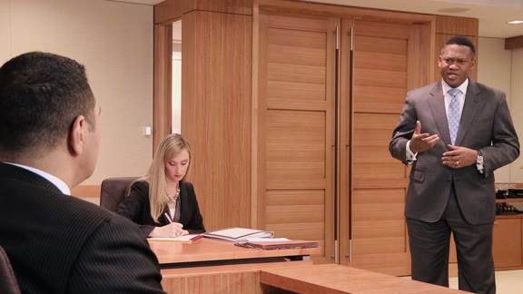
Cross Exams of Their Witnesses

Slide 44
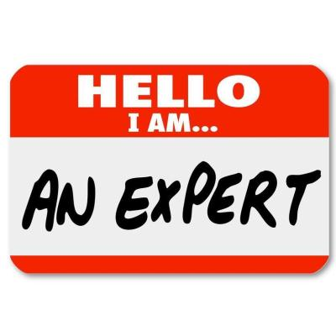

Slide 45
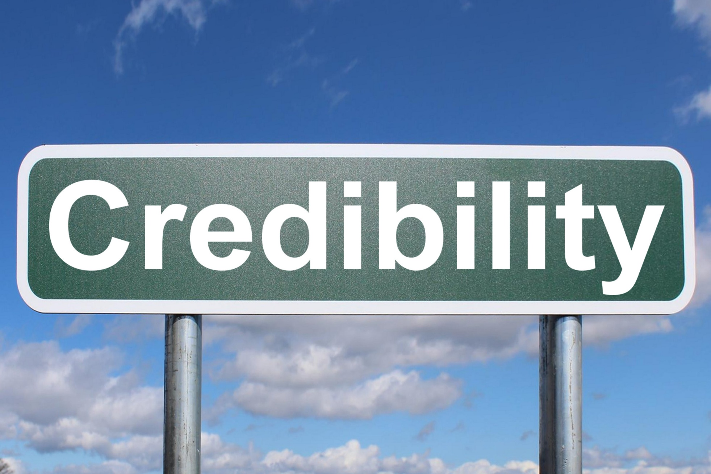

Slide 46
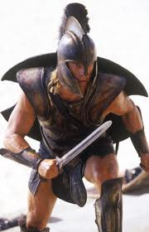
Achilles’ Heels
Damaging admissions
Inconsistent statements
Violations of policies
Contributory negligence
Prior injuries
Delays in treatment
Criminal records

Slide 47
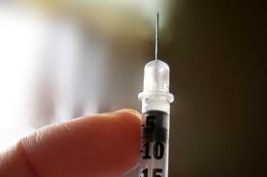
Gerry Spence:
“A concession coming from your mouth is not nearly as hurtful as an exposure coming from your opponent’s.”
Can be forgiven for wrongdoing, but cannot be forgiven for wrongdoing we tried to cover up.

Slide 48

The Rice-Leggett Study

Slide 49
Rice-Leggett Study (1993)
Crash-worthiness suit.
1. Plaintiff drinking alcohol before.
2. Autopsy- alcohol in blood.
Two groups of 75: inoculation group and sponsorship group.

Slide 50
Rice-Leggett Study
Both: Same D opening with drinking.
Sponsorship: P’s opening – no drinking.
Inoculation: P’s opening with drinking, but no reputation as drinker and alcohol not > legal limit.

Slide 51
Rice-Leggett Study
Inoculation group:
Inoculating atty more honest, organized, persuasive, poised and effective than non-inoculating P’s atty.
D’s atty less honest, organized, persuasive, effective, and more nervous than sponsorship group.

Slide 52
Rice-Leggett Study
Inoculation group: P - 50%
Sponsorship group: P - 43%

Slide 53
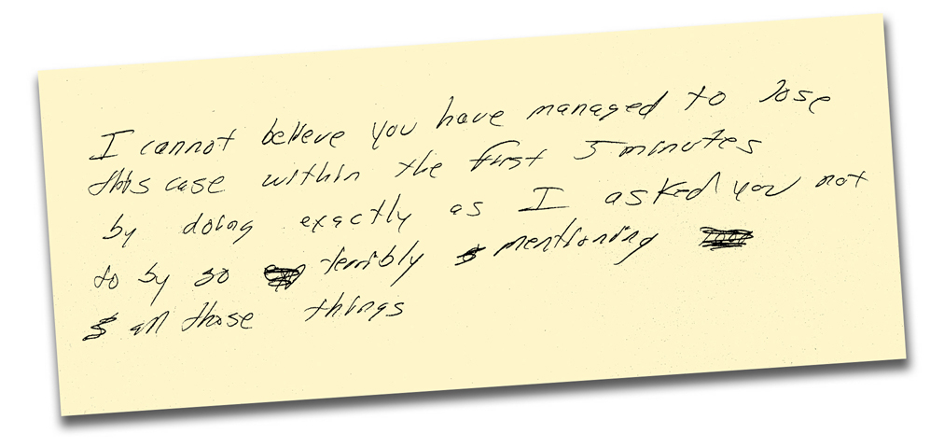
One Client’s Reaction

Slide 54

The Reptile

Slide 55
Three Questions For Jurors
1. How likely was it that act would
hurt someone?
2. How much harm could it have
caused?
3. How much harm could it cause
in other kinds of situations?

Slide 56
Safety Rules
1. Must prevent danger.
2. Must protect people in a wide
variety of situations, not just P.
3. Must be in clear English.
4. Must explicitly state what person
must or must not do.

Slide 57
Safety Rules
5. Must be practical and easy for
someone in D’s position to
follow.
6. Must be rule D has to agree with
or reveal himself as stupid,
careless, or dishonest.

Slide 58
Opening Template - Ball & Keenan
1. Rule and consequences
(“Anyone who runs a store is
required to …”)
2. Story of what the defendant did.
3. Why we’re suing (“We’re suing
the defendant for violating six
important safety rules”)

Slide 59
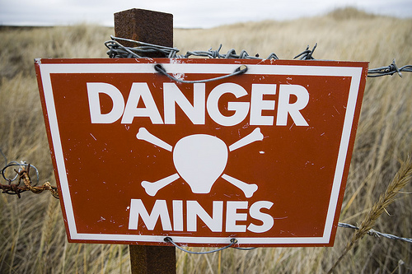

Slide 60
Strategy and Mindset
1. Don’t over-promise
2. Be completely candid
3. ALWAYS be credible
4. Avoid insincerity
5. Don’t hide bad facts
6. Avoid personal attacks
7. Don’t violate limines.

Slide 61
Conclusion

