Slide 1


The Modern Deposition: Balancing Cognitive Load in Witness Testimony with AI
www.fullproof.ai

Slide 2

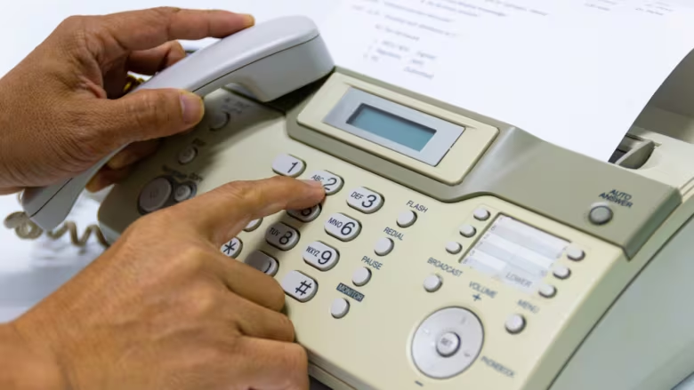
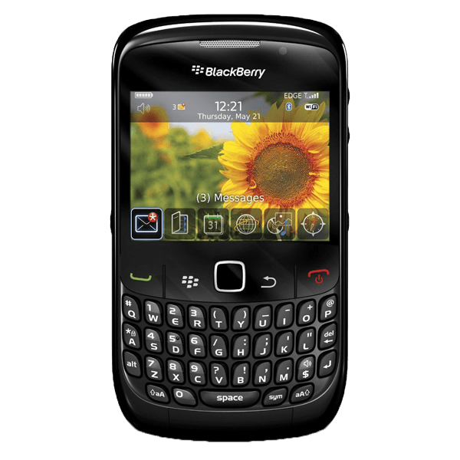

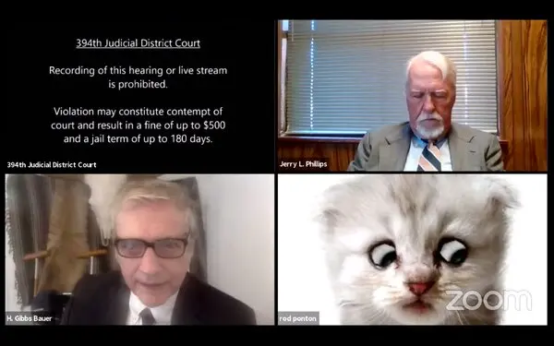
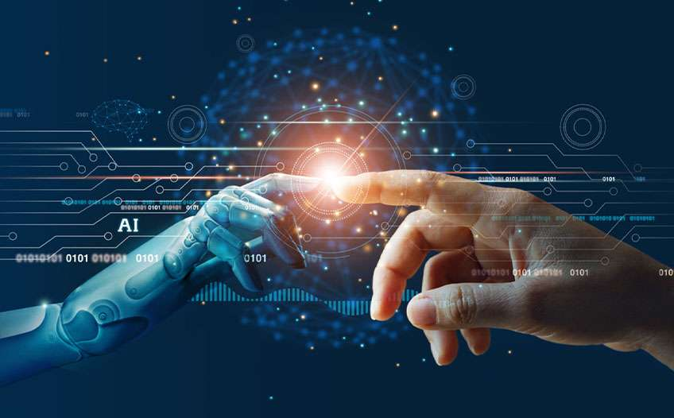
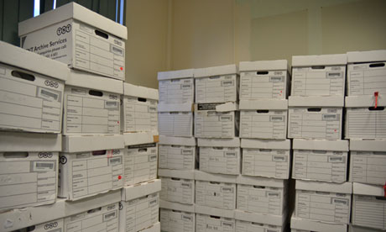
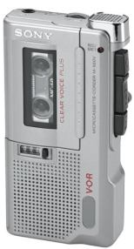
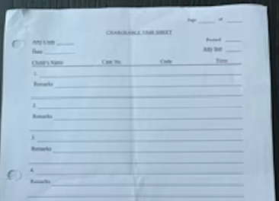
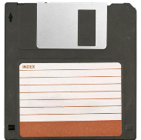

The Evolution of Legal Technology
Lawyers Aren’t Slow to
Adopt Tech
…When It’s Useful
Fax Machines & Handwritten Timesheets
Banker Boxes, Floppy Disks, & Dictation Recorders
Blackberry, Email, & E-Discovery
Virtual Court Appearances & Depositions
Legal AI
Private & Confidential. Patent Pending. 2026 © FullProof Systems Inc. All Rights Reserved.

Slide 3
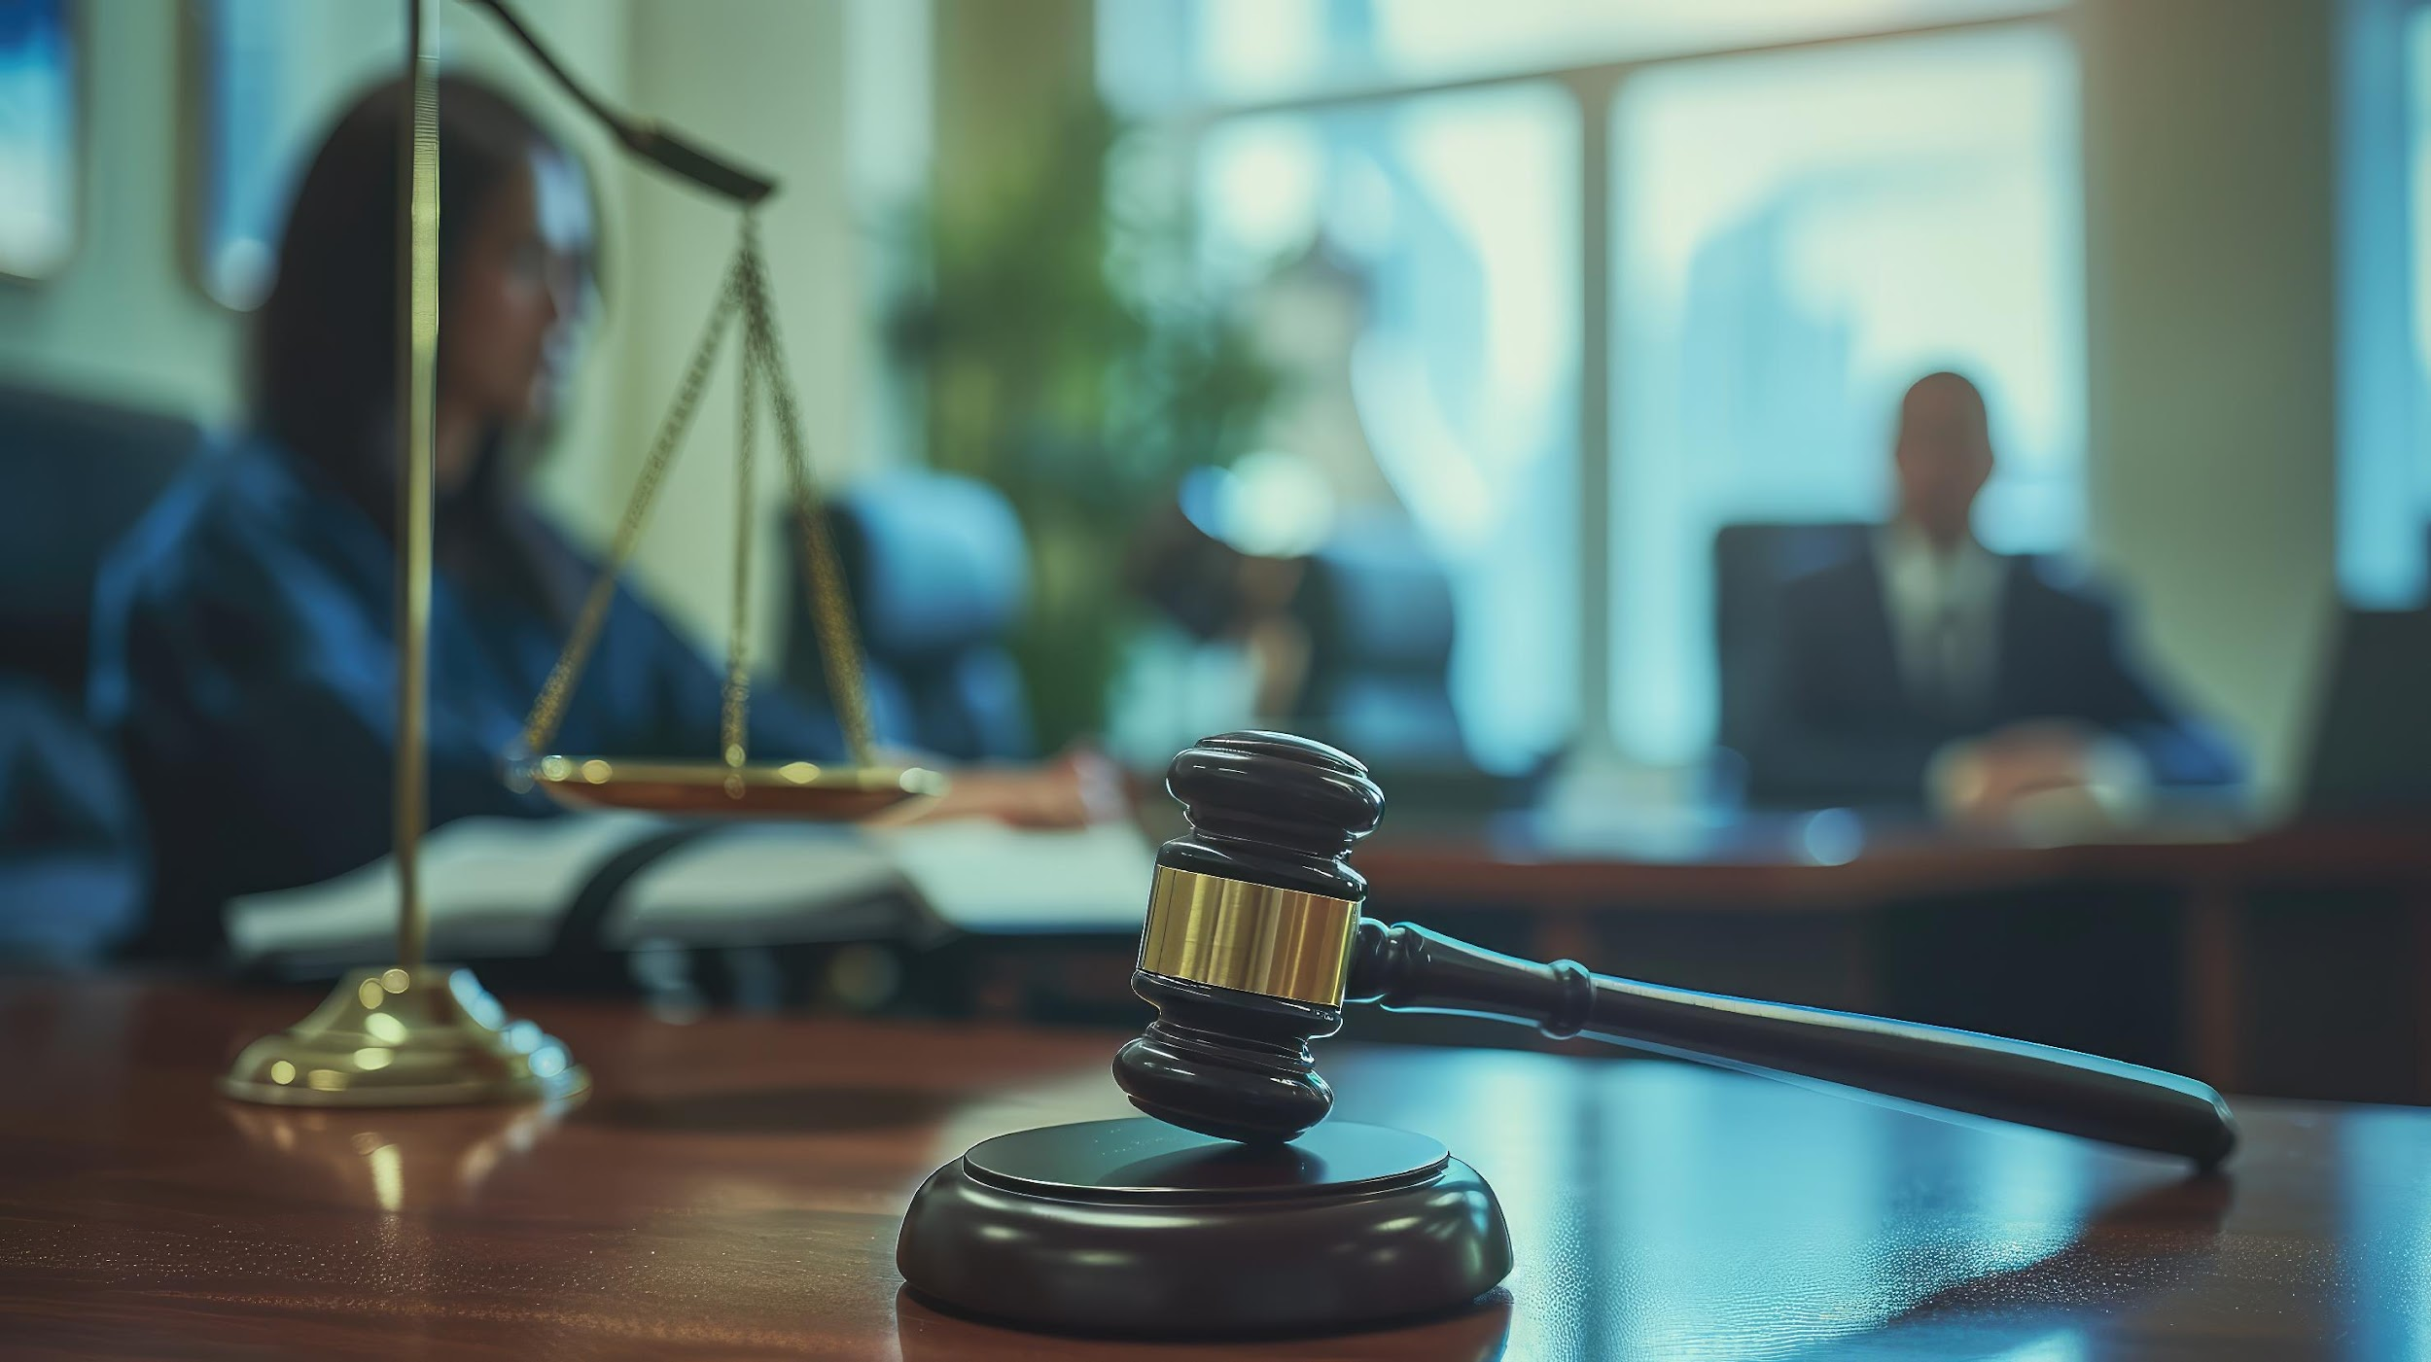
The Reality
Outcomes are decided in depositions, not trial
97% of cases settle before trial
Private & Confidential. Patent Pending. 2026 © FullProof Systems Inc. All Rights Reserved.

Slide 4

The Drive Home Moment…
…when you realize what you missed.
Every litigator has had it.
Most of us don't talk about it.
www.fullproof.ai
Private & Confidential. Patent Pending. 2026 © FullProof Systems Inc. All Rights Reserved.

Slide 5
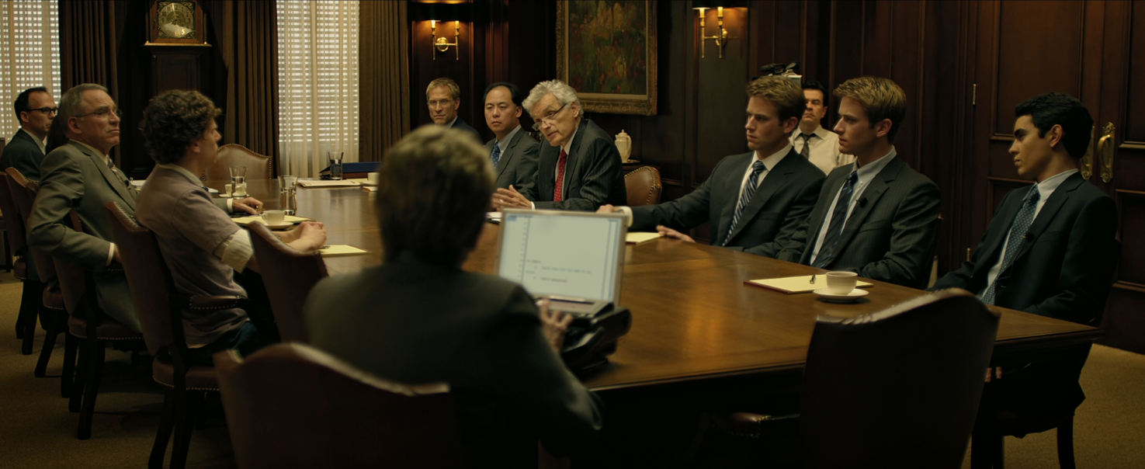
The Action
Catching Contradictions
Listening for Substance
Tracking the Outline
Planning Next Questions
All at once.
With no second take.
Anticipating Objections
Watching Opposing Counsel
Managing Exhibits
Evaluating Credibility
Private & Confidential. Patent Pending. 2026 © FullProof Systems Inc. All Rights Reserved.

Slide 6
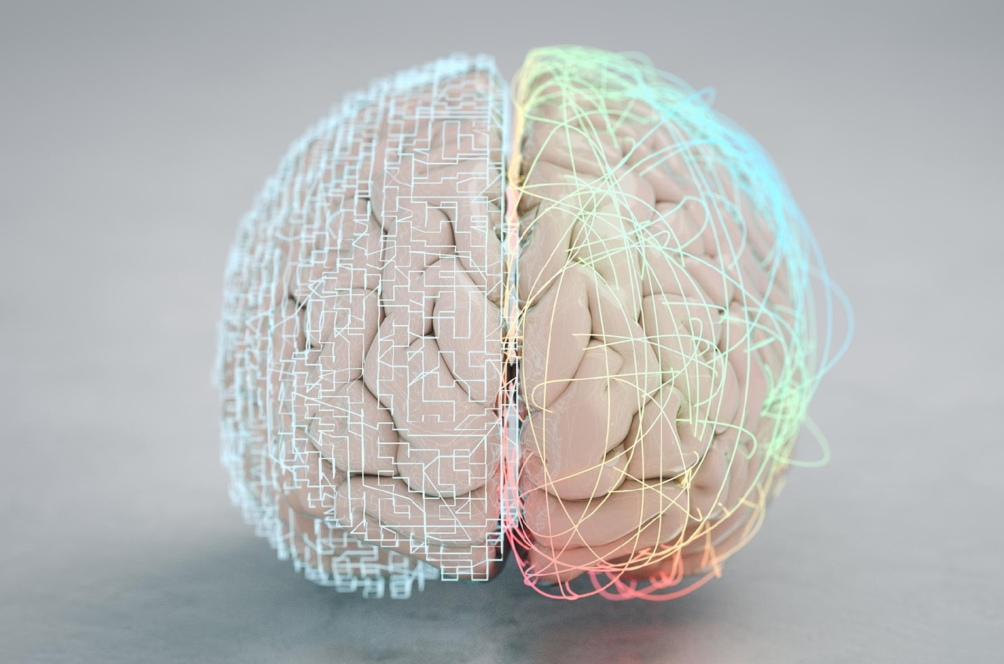
The Brain Math
Listening
Watching the witness
the contradiction you meant to catch
the follow-up you meant to circle back to
the witness’s pause you didn’t register
the exhibit you never marked
Anticipating objections
Planning next questions
Managing exhibits
Tracking the outline
Catching contradictions
Watching opposing counsel
A witness speaks at 2-3 tokens per second. Strategic reasoning runs at less than 1.
Working memory holds 4 items. The room demands 10+.
The brain sheds the rest.
Private & Confidential. Patent Pending. 2026 © FullProof Systems Inc. All Rights Reserved.

Slide 7
Cognitive Shedding
Non-answers…
The Unanswered Question
Witness contradictions…
The Buried Inconsistency
The Exhibit Fumble
Hunting for the right document…
You meant to circle back…
The Follow-Up Never Came
This is not a personal failing.
This is what cognitive overload looks like.
Private & Confidential. Patent Pending. 2026 © FullProof Systems Inc. All Rights Reserved.

Slide 8
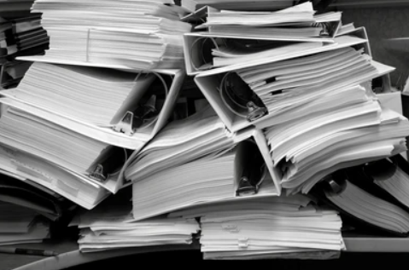
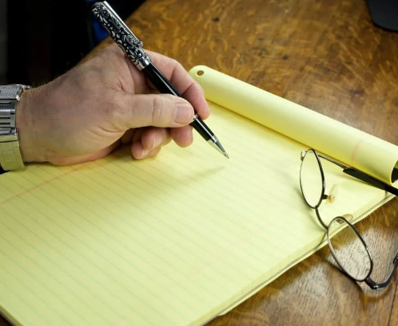

Today’s State of the Art
Our Limited Cognition
& Memory
Binders
Notepads
Private & Confidential. Patent Pending. 2026 © FullProof Systems Inc. All Rights Reserved.

Slide 9
The Modern Deposition: 4 Principles
1) Prepare for the deposition you’ll actually take
2) Outline as a map, not a script
3) Defend the record, not just the witness
4) Build a second chair into your prep
Private & Confidential. Patent Pending. 2026 © FullProof Systems Inc. All Rights Reserved.

Slide 10
Where AI Belongs…and Where It Doesn't
Belongs
Emerging
Pass
Pre- and post-deposition
Cross-referencing outlines against discovery
Exhibit organization and indexing
Witness background synthesis
Transcript analysis after the fact
Contradiction-spotting in produced documents
Stakes of error: recoverable
Live, in-deposition
Real-time transcription with analysis
Contradiction flagging as the witness speaks
Suggested follow-ups during examination
Tracking exhibits and topic coverage
The cognitive-load relief frontier
Use with care. Vet your tools.
Human judgment only
Witness credibility assessment
Strategic calls on push vs. drop
Reading silence and body language
The decision to dig or to cut losses
Anything requiring years of feel
This is what you’re paid for.
Private & Confidential. Patent Pending. 2026 © FullProof Systems Inc. All Rights Reserved.

Slide 11
Treat it as a work product.
Using AI in Depositions:
Staying on the Right Side of
the Rules
Keep the output on your side of the table.
Be transparent about transcription.
The court reporter’s transcript is the record.

Slide 12
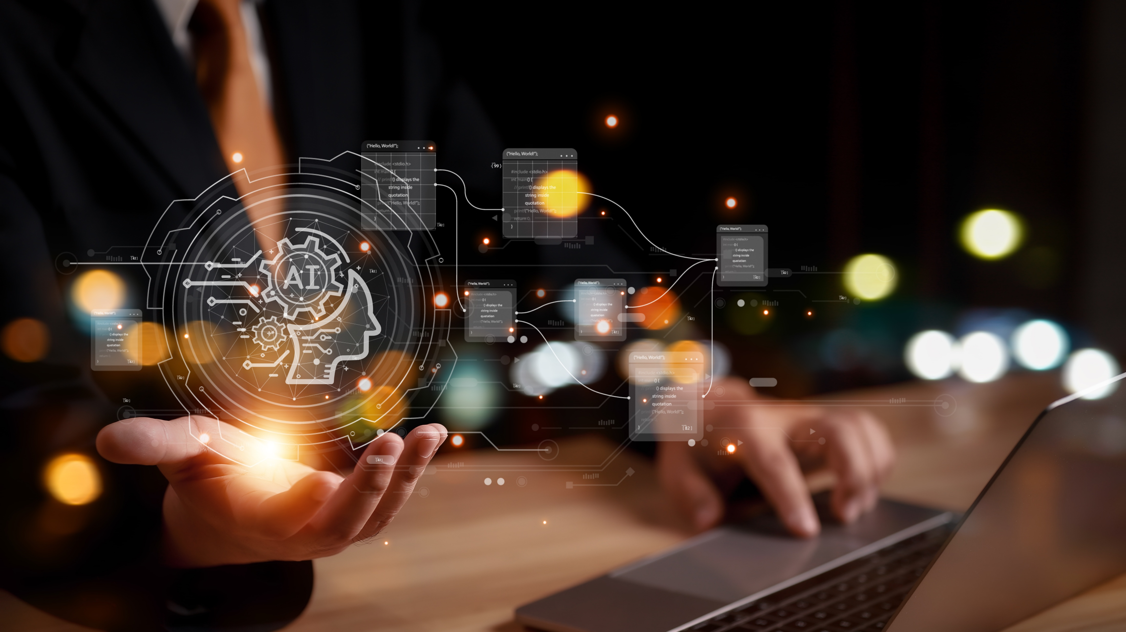
The lawyers who thrive
in the next decade will achieve balance
They won’t be the ones who resist AI.
But they also won’t be the ones who outsource their judgment to it.
They’ll be the ones who understand the craft
deeply enough to know exactly where
a second chair – human or machine –
earns its seat at the table.
www.fullproof.ai

Slide 13
That’s the power
of depositions.
And it shouldn’t take twenty years
of practice and luck to get there.
Notes:
This slide follows a personal anecdote.

Slide 14





Neda Mansoorian
neda@fullproof.ai
neda-mansoorian24
www.fullproof.ai
Private & Confidential. Patent Pending. 2026 © FullProof Systems Inc. All Rights Reserved.

