Slide 1
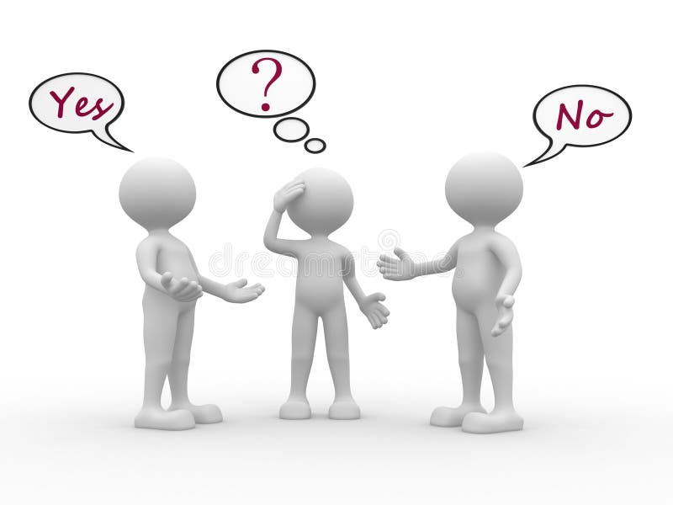
Influence & Sway: Differences in Pre-suasion, Persuasion, and Post-suasion
Andrew Bringuel, II
Executive Director Behavioral Science Unit, LLC
www.behavioralscienceunit.com
(703) 401-7260
For Legal Up

Slide 2
Takeaways -
* Relationships = balance trust and control, against a baseline of predictable behavior.
* Man is naturally self-interested not selfish or selfless
* Message, Messenger, Methods of delivery (3Ms).
* Applicable to sales, FBI agents, lawyers, and paralegals…everyone
Influence & Sway: Differences in Pre-suasion, Persuasion, and Post-suasion
For Legal Up

Slide 3
The principles discussed today apply:
Relationships are simply complex! It’s the nuance that’s the nuisance!
Influence & Sway – FBI Agents do two things… develop relationships and disrupt relationships….
Cognitive flow - biology, psychology, and sociology (Biopsychosocial) mixed with context (time & space) which manifests into rationalized decision making (cognition) that is balanced between emotional drivers and instrumental calculations...
Influence & Sway: Differences in Pre-suasion, Persuasion, and Post-suasion
For Legal Up

Slide 4
The principles I’ll discuss today:
Influence & Sway = Three Ps used to create a relationship with trust & control against a baseline of expected behaviors.
Pre-suasion & Persuasion rely on rapport, and rapport creates trust, and trust balances control. Post-suasion maintains/manages the trust and control in all relationships.
Biopsychosocial + Context = Rationalized decision making (cognition)...
FBI Agents do two things… develop relationships and disrupt relationships….
Relationships are simply complex! It’s the nuance that’s the nuisance!
Influence & Sway: Differences in Pre-suasion, Persuasion, and Post-suasion
For Legal Up

Slide 5

Man is born self-interested… not selfish or selfless, but biologically wired to survive
Personal, Economic, Political (Power), Social (PEPS Matrix)
The three Ps represent the full Psychological Arch of Influence and Sway:
  Pre-suasion – shaping mindsets before delivering a message
  Persuasion – influencing decisions with the right messenger, delivering the right message with the right method of delivery.
  Post-suasion – reinforcing commitment to the relationship, balancing trust/control to satisfy self-interests of all parties.
  Robert Cialdini’s (Pre-suasion), his core idea – "People are most persuadable BEFORE the message is delivered."
Influence & Sway: Differences in Pre-suasion, Persuasion, and Post-suasion
For Legal Up

Slide 6
Influence & Sway: Differences in Pre-suasion, Persuasion, and
Post-suasion
Ori Braufman (SWAY: The Irresistible Pull of Irrational Behavior)
  People make irrational decisions when they believe they are being logical
  Loss Aversion – People fear losses more than they value equivalent gains.
  Value Attribution is shared by context – People often judge value based on perception, labels, or context rather than actual quality. Saks Fifth Ave. Vs. Walmart.
  Value Modeling – Experts & Celebrity opinion shapes what people think.
      “Expensive” products must be better than the cheaper versions.
      A Brand product has higher value than generic product.
For Legal Up

Slide 7
Influence & Sway: Differences in Pre-suasion, Persuasion, and
Post-suasion
  Diagnostic Bias – often first impression – Once people form a conclusion, people unconsciously seek evidence that confirms their conclusion and ignores evidence that contradicts it, also known as Confirmation Bias.
  Chameleon Effect – Human imitate the behaviors (mirroring), speech patterns (active listening), and emotions of others.
For Legal Up

Slide 8
Influence & Sway: Differences in Pre-suasion, Persuasion, and
Post-suasion
  Use in Voir Dire & Trial -
  Loss Aversion - juror’s fears: Dangerous precedents, harm to society, letting guilty parties escape, punishing innocent people
- How the case is framed around “loss” matters!
Commitment Bias - Once jurors begin leaning in one direction, they defend that position psychologically. Early framing matters enormously.
Value Attribution - Presentation affects perceived credibility, polished visuals, organized evidence, and confident delivery.
For Legal Up

Slide 9
  Pre-suasion – Focus less about the outcome, and more about the output (crafting the message)
Branding – Psychodynamic Modeling - political slogans – Just do it!
Emotional Association – Value Modeling - attaching an emotion to object (flag), idea (capitalism), experience (birthday)
Identity – Social/Cultural Modeling - sports team, political party, race, religion
Trust Signals – Cultural Modeling – customer reviews on social media, a Nike Swish
Perceived Authority – Value Modeling – some perceived “expert”, Dr., cable news pundits
Influence & Sway: Differences in Pre-suasion, Persuasion, and Post-suasion
For Legal Up

Slide 10
Robert Cialdini wrote in Influence – Authority, Scarcity, Social Proof, Liking, Reciprocity, Consistency, Unity.
Authority - People are influenced by authority, people follow experts or power (similar to Webb's perceived authority )
Scarcity – Rare, exclusive, or limited perceived as more valuable and people want it…
Social Proof – See others & they follow suit (similar to Trust Signaling), follow the crowd… can lead to Deindividuation –psychological term for loss of personal identity within group or crowd.
Liking – key to influence - when people agree with others like them... race, hometown, religion, sports team.
Reciprocity – When we are gifted, we feel compelled to return the favor. Knights of Columbus tootsie roll
Consistency/Commitment – Key, once we make a commitment, we tend to fulfill that commitment… moral absolutists
Unity – Social Learning Theory - The more we identify with others, the more we are influenced by their behavior. In criminology this is described as differential association... (similar to Webb's Social Identity).
Influence & Sway: Differences in Pre-suasion, Persuasion, and Post-suasion
For Legal Up

Slide 11
Influence & Sway: Differences in Pre-suasion, Persuasion, and Post-suasion
Voir Dire – is not just jury selection it is psychological framing​
​
Before opening statements even begin:​
Jurors bring their pre-suaded(sic) biases​
Jurors form impressions as quickly as two seconds (Malcolm Gladwell - Blink)​
As soon as the lawyer speaks, rapport begins, and trust is either formed or lost​
Emotional anchors are set ​
Value definitions ​are made
Narratives begin to form ​
Pre-suasion techniques for a lawyer may include:​
  Tone of voice ​
  Dress and confidence​
  Word choice​
  Physical positioning ​
  Establishing fairness​
  Framing themes using potential juror’s identified anchors as social values, how anchors are defined, and how the defined values form a narrative
For Legal Up

Slide 12
Influence & Sway: Differences in Pre-suasion, Persuasion, and Post-suasion
Voir Dire – is not just jury selection it is psychological framing​ through pre-suasion techniques
​Goals in Voir Dire:
Deselect juror(s) by gathering information, asking open ended questions attempting to learn potential juror’s anchors, value definitions, and narrative, build rapport, by using "liking". Expose hidden bias. Create emotional alignment. Framing the trial narrative and establishing expertise and credibility.
For Legal Up

Slide 13
Influence & Sway: Differences in Pre-suasion, Persuasion, and Post-suasion
Gavin De Becker (The Gift of Fear)
Intuition - He says if we listen to our inner threat assessment voice (fear), we can sense danger...
Awkward conversation - We use avoidance which is one of five conflict resolution styles, along with competing contending, collaboration, compromise, and accommodation.
A lawyer has to address juror’s fears…
A lawyer’s nonverbal communication matters enormously:
Pauses
Eye Contact
Pacing
Emotional Congruence – align emotion with expression
For Legal Up

Slide 14
Influence & Sway: Differences in Pre-suasion, Persuasion, and Post-suasion
Persuasion -
The active influence stage – MESSAGE and MESSENGER
The Lawyer is the courtroom equivalent of the salesperson, or FBI HUMINTER
Persuasion in sales:
Taking what was learned from, or implied from the customer's pre-suasion experience and:
  Have that awkward conversation, solve emotional problems, create urgency, reduce fear, build trust, simplify decisions.
  The best salesperson, lawyer, or FBI Agent: listens first, identifies emotional drivers (PEPS), tailors the message to personality type, and selects the best messenger and method to deliver the message.
For Legal Up

Slide 15
Influence & Sway: Differences in Pre-suasion, Persuasion, and
Post-suasion
Lawyers:
Simplify complex narratives; build emotional resonance, establish emotional framing, build rapport, create trust, reduce uncertainty, prime expectations, provide moral clarity, and create a ‘story’, not an information dump.
PEOPLE DECIDE EMOTIONALLY FIRST, THEN RATIONALIZE LATER! - Ori Brafman, Nicholas Webb and Robert Cialdini!
For Legal Up

Slide 16
Influence & Sway: Differences in Pre-suasion, Persuasion, and
Post-suasion
Post-suasion transferred to law practice:
Clients judge law firms the way customers judge brands
Clients remember responsiveness, empathy, clarity, confidence, transparency
Paralegals often become the emotional bridge, trust stabilizers, expectation managers
Post-suasion - What happens after the decision - This is often overlooked
Post-suasion in Customer Service - Customer service reinforces buyer confidence, loyalty, emotional validation, reduces regret, and creates client referrals
Companies use - Follow-up emails, appreciation discounts, consistency, problem resolution
Transfer to lawyers and paralegals - Post-suasion in law = Maintaining trust, client retention
Clients often experience - Fear, uncertainty, regret, stress, second-guessing
For Legal Up

Slide 17
Influence & Sway: Differences in Pre-suasion, Persuasion, and
Post-suasion
  Paralegals and attorneys reinforce commitment by - Consistent communication, professionalism, updates, empathy, and clarity
  Post-suasion in Jury Deliberation - After persuasion there is reinforcement during closing statement.
  Trial lawyers – In closing will repeat core themes, simplify key emotional anchors, leave memorable phrases, and provide jurors a consistent narrative. Jurors psychologically seek consistency with earlier their impressions.
  Cialdini’s principle of consistency and commitment - Once people publicly or mentally commit to a position, they resist changing their "minds".
For Legal Up

Slide 18
Influence & Sway: Differences in Pre-suasion, Persuasion, and
Post-suasion
Persuasion - Tell stories, don’t lecture, reduce cognitive overload, simplify themes, use emotional resonance ethically, build trust through consistency, address juror’s fears directly
Post-suasion - Reinforce themes repeatedly, leave memorable emotional anchors, maintain client trust after retention, use consistent communication, reduce uncertainty and regret, support jurors’ need for narrative coherence
For Legal Up

Slide 19
Influence & Sway: Differences in Pre-suasion, Persuasion, and
Post-suasion
  Core Combined Insight:
Across all these authors, the central lesson is:
  Human beings are influenced far more by emotion, framing, subconscious bias, intuition, and social psychology than by pure logic.
  Lawyers, Paralegals, Salespeople, and FBI Agents Understand:
      Persuasion begins before words, trust outweighs information, framing shapes perception, emotional safety affects decisions
      Consistency reinforces belief
      People justify emotionally driven conclusions with logic afterward
For Legal Up

Slide 20
Influence & Sway: Differences in Pre-suasion, Persuasion, and
Post-suasion
Questions?
Andrew Bringuel, II
Executive Director Behavioral Science Unit, LLC
www.behavioralscienceunit.com
(703) 401-7260
For Legal Up

