Slide 1
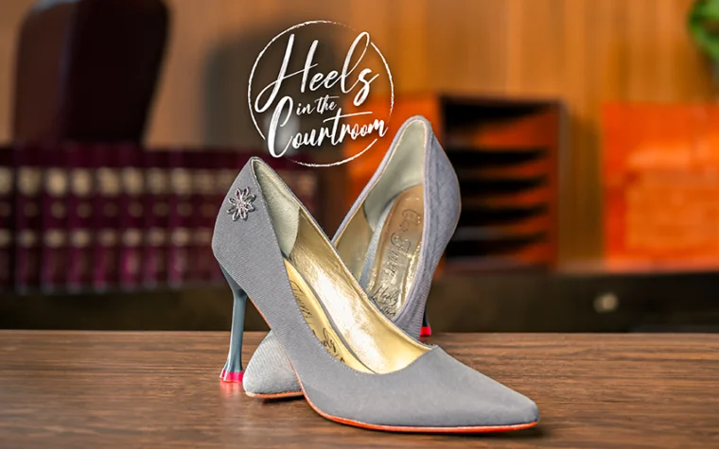
Simon Law Firm

Slide 2
Damages That Drive Verdicts
Some cases settle for their value.
Others command their value.
Notes:
Liz opens. Quick intros. Set expectation: practical, real-world strategies.

Slide 3
Core Thesis
Built at intake
Reinforced through Discovery and Depositions
Realized at trial
Notes:
Frame entire CLE around this lifecycle.

Slide 4
Roadmap
Intake & Case Selection
Early Damages Development
Depositions
Experts
Trial
Notes:
Preview sections and speakers.

Slide 5
Case Snapshot
Sarah Mitchell (42 )
Elementary school teacher
Rear-ended at a red light / low speed collision (admitted liability)
Injuries: Whiplash / Cervical spine injury → chronic pain, limited range of motion, headaches
$85k medical bills
Defense Positions: “Soft tissue, improved, back to work = modest value”
Notes:
Introduce running case.

Slide 6
What is this case really worth?
Notes:
Ask audience to think of number.

Slide 7
Case Value Contrast
Baseline
$150k–$250k
Medical-driven
Verdict-Driven
$750k+
Story-driven
Notes:
Same facts, different build.

Slide 8

The ceiling is set at intake.
Notes:
Transition to intake.

Slide 9
What Drives Value
Human loss
Clarity of harm
Juror relatability

Slide 10
Would a juror care after 2 hours?
Notes:
Reframe intake.

Slide 11

Intake Framework
What changed?
What do you miss?
Who noticed?
Notes:
Sydney leads.

Slide 12
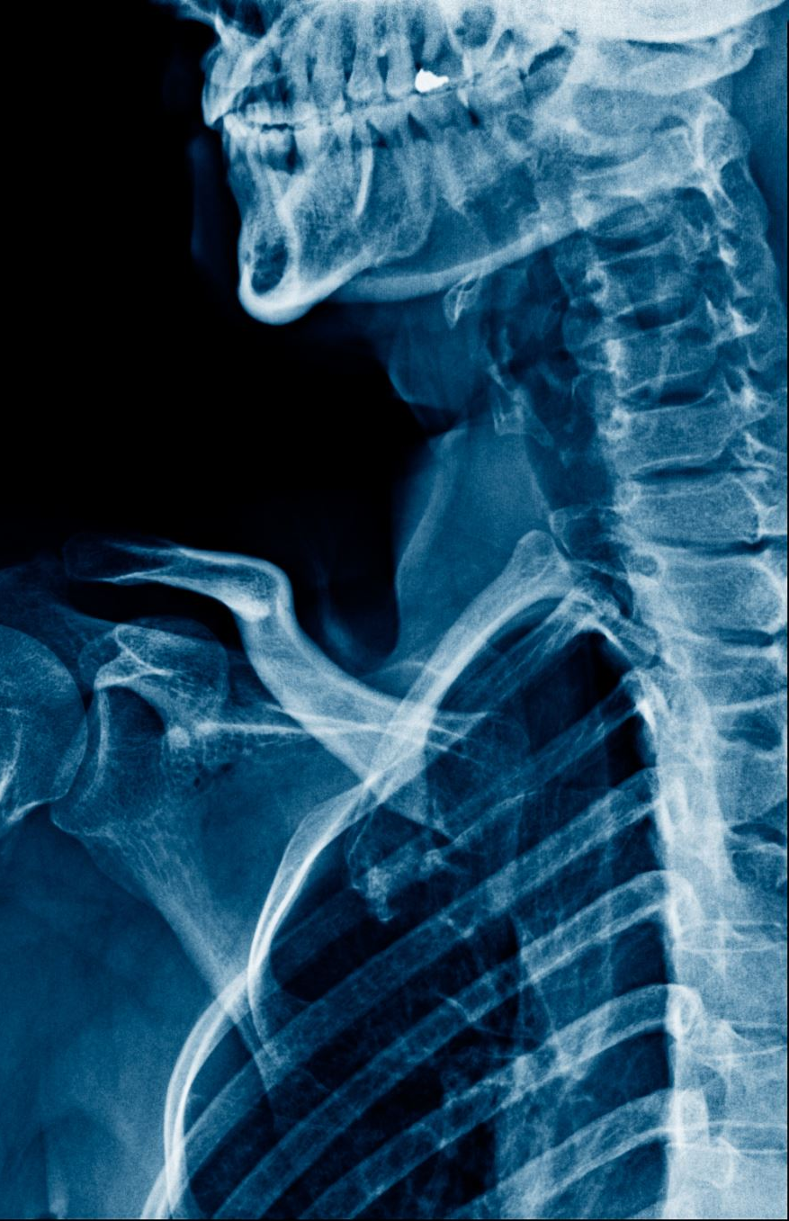
What You Hear
Neck pain
Headaches
Still working

Slide 13
What You Discover
Can't sit with students
Teaches from chair
Withdraws at home

Slide 14
Before vs After (Teacher)
Before
On the floor
Engaged
Connected
After
In a chair
Detached
Limited
Notes:
Visual anchor.

Slide 15
This isn’t a neck injury case.
It’s a loss of identity.

Slide 16
Build early or not at all.
Notes:
Katie leads.

Slide 17
Damages Theory Memo
Theme
Proof
Witnesses

Slide 18
Case Theme
She lost how she teaches

Slide 19
Client Development
Track change
1
Capture setbacks
2
Help articulate
3
Notes:
Mary leads.

Slide 20
Depositions don’t lose cases— but they cap value.
Notes:
Elizabeth leads.

Slide 21
Taking Depositions
Build narrative
Lock language
Validate harm

Slide 22
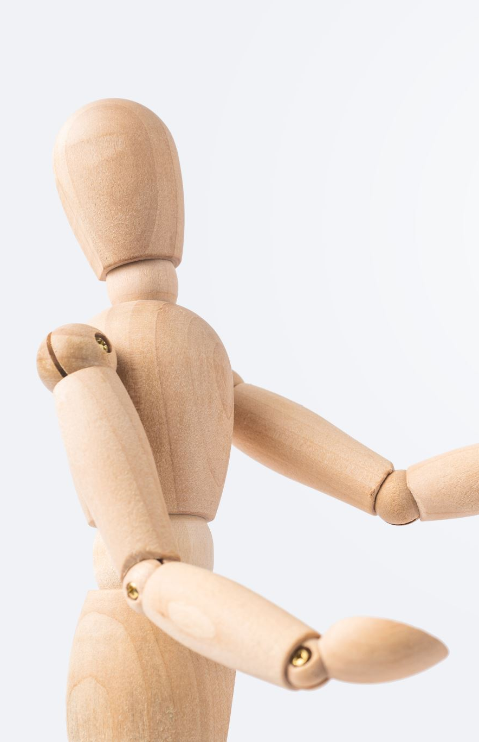
Prep Plaintiff
No minimizing
No exaggerating
Be specific

Slide 23
Bad vs Good Answer
Bad
I'm okay
I've adjusted
Good
I'm not the same teacher
I lost connection
Notes:
Audience favorite.

Slide 24
Defending
Protect tone
1
Avoid over-objecting
2
Preserve credibility
3

Slide 25

Experts should amplify. not explain.
Notes:
Sydney/Katie.

Slide 26
Choosing Experts
Teach clearly
Connect to life
Support theme

Slide 27
Using Experts
Plain language
Tie to daily impact
Validate

Slide 28
Expert Impact
Weak
Technical
Detached
Strong
Clear
Validates life impact

Slide 29
If jurors don’t feel it,
they won’t value it.
Notes:
Liz leads trial.

Slide 30
Themes
What was taken
Before/After
Cost of harm

Slide 31
Witness Order
1. Expert Witness
2. Fact Witness
3. Client

Slide 32

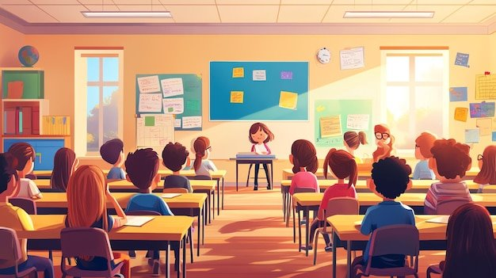
demonstratives

Slide 33
Story Timeline
Before
Incident
Treatment
Now

Slide 34
What Works
Visuals
Simple timelines
Real stories

Slide 35
Closing
Meaning first
Loss
Fairness
Accountability
Notes:
Mary closes trial section.

Slide 36
Every day she walks into that classroom,
she’s reminded what she lost.

Slide 37
Same case. Different value.

Slide 38
Why This Works
No catastrophic crutch
Human story
Relatable

Slide 39
Built from first conversation to final word.

Slide 40
At intake—would you have seen the value?
Notes:
Audience engagement.

Slide 41
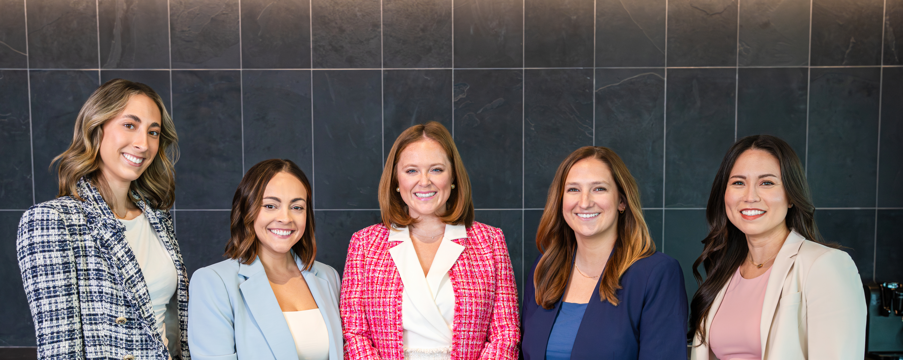
Q&A
Thank you
Notes:
Liz moderates.

