Slide 1
PRESENTATION · INFOTRACK
High Performance
in Practice
How Lawyers and Legal Professionals Build Teams,
Systems, and Careers That Don't Break Under Pressure
Eda Rosa · Limitless Paralegal Academy Founder · Professor · Let's Talk Paralegal Podcast Host · Author
By: Eda Rosa LLC

Slide 2
THE PERFORMANCE PARADOX
Working harder. Falling further behind.
WHAT MAYBE HAPPENING?
THE SHIFT
Billing hours at full capacity and still behind on strategy
Managing crises instead of building systems
Talented people who stay invisible inside the firm
Teams running fast in different directions
Burnout masked as commitment
High performers aren't just working harder,
they are working with intention.
Here I will give you the framework to make that shift regardless of your practice area, title, or career stage.
1 / 14

Slide 3
SEGMENT 02
Workflow Mastery
Across Practice Areas
Where time goes · The triage framework · Building systems that scale
2 / 14

Slide 4
WORKFLOW MASTERY
Where Legal Professionals Misplace Time
Litigation
Reactive fire-fighting instead of planned preparation
Transactional
Endless revision cycles with no version control discipline
Real Estate
Last-minute due diligence gaps and closing day chaos
Immigration
Redundant data entry across forms and portals
Corporate
Meeting overload masquerading as collaboration
3 / 14

Slide 5
THE THREE-PART TRIAGE FRAMEWORK
Reclaim Your Time, Starting Today
1 IDENTIFY
2 PROTECT
3 SYSTEMATIZE
The Real Time Drains
High-Value Time
Everything That Repeats
Audit your last two weeks: where did time go vs. where did it need to go?
Distinguish urgent-but-unimportant from truly high-value work
Name the top three recurring time leaks in your practice
Name the top three recurring time leaks in your practice
Block non-negotiable focus time before the week fills itself
Build matter templates that eliminate repetitive decision-making
Set communication boundaries that reduce interruption without damaging relationships
Set communication boundaries that reduce interruption without damaging relationships
Document your workflows, even simple ones, so they can be delegated or improved
Create checklists for every matter type you handle repeatedly
Build a personal system that scales with your caseload, not against it
Build a personal system that scales with your caseload, not against it
5 / 14

Slide 6
SEGMENT 03
Communication That
Protects Relationships
and Results
Managing up · Managing across · Managing down · Closing the visibility gap
6 / 14

Slide 7
THE COMMUNICATION MATRIX
How You Communicate In Every Direction Defines Your Career
↑ Managing Up
↔ Managing Across
↓ Managing Down
Set expectations before you're asked to report on them
Frame problems with proposed solutions, not just alerts
Know when to push back and how to do it without burning trust
Build peer relationships before you need favors
Communicate timelines clearly to avoid collision
Credit others generously, it compounds over time
Give direction that is clear, not just fast
Build in checkpoints, not last-minute surprises
Lead support staff in a way that earns loyalty, not just compliance
7/ 14

Slide 8
THE VISIBILITY GAP
Why Talented Legal Professionals Stay Invisible and How To Change It
The legal profession rewards effort. But it advances people who make their impact visible.
The Gap
The Language Shift
You're doing excellent work that no one above you can see or measure. Effort without visibility is a career ceiling.
Stop reporting what you did. Start communicating what it produced. Outcomes > activities — always.
Build It Intentionally
The Long Game
Internal reputation is built in the small moments: how you show up in meetings, how you follow up, how you advocate for your team.
Career capital compounds. One well-placed comment in a partner meeting can do more than three months of quiet excellent work.
8 / 14

Slide 9
SEGMENT 04
High-Performing Teams
& Sustainable Practice
What high performers do differently · Burnout signals · Sustainable ambition
9 / 14

Slide 10
HIGH-PERFORMING LEGAL TEAMS
What They Do Differently And How You Build That Culture From Where You Sit
Clarity over speed
They define what 'done' looks like before starting. Rework is the enemy of high performance.
Accountability without micromanagement
Clear ownership, defined checkpoints, and a culture where people raise problems early.
Psychological safety
Team members speak up, flag risk, and ask questions, which prevents the costly errors that derail matters.
Systems, not heroics
They don't rely on one person running at 120%. They build processes that distribute the load.
Visible leadership at every level
High-performing teams are led from the front and from the middle, and from the support staff seat.
10 / 18

Slide 11
SUSTAINABLE HIGH PERFORMANCE
Ambition without attrition
BURNOUT — RECOGNIZE IT EARLY
YOUR SUSTAINABILITY FRAMEWORK
Chronic exhaustion that sleep doesn't fix
Cynicism about work that once felt meaningful
Declining quality in work you normally do well
Detachment from colleagues and clients
The sense that no matter how hard you work, it is never enough
Boundaries Protect what you need to perform — not what is comfortable to protect
Recovery Recovery is not weakness. It is the operating condition for sustained excellence
Meaning Reconnect to why this work matters. Purpose is a performance multiplier
Systems Build workflows that protect your capacity, not just your deadlines
11 / 14

Slide 12
SEGMENT 05
Application + Q&A
Key takeaways · Your Monday commitment · Open Q&A
12 / 14

Slide 13
YOUR MONDAY MORNING TAKEAWAYS
Pick one. Implement it this week.
01
04
Audit your time
Build one checklist
Look at the past two weeks and name your top three time drains. Write them down.
Pick one matter type you handle repeatedly. Document the workflow this week.
02
05
Set one boundary
Schedule recovery
Identify one recurring interruption you will handle differently starting Monday.
Block one non-negotiable recovery window per week. Treat it like a client call.
03
06
Shift your language
Make your impact visible
In your next update to leadership, report outcomes — not just activities.
Send one message that communicates what your recent work produced — not just what you did.
13 / 14

Slide 14
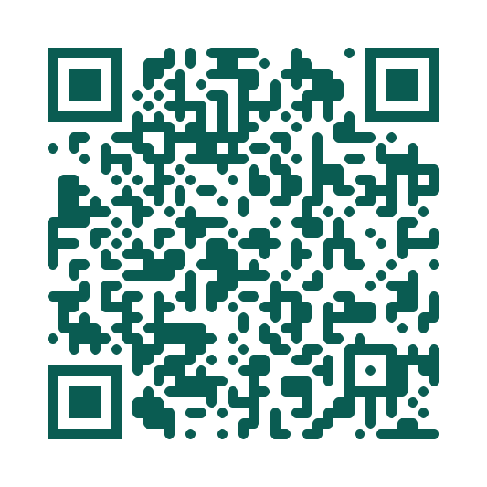
THANK YOU
The work you do matters.
Do it with intention.
Eda Rosa
Limitless Paralegal Academy
Let's Talk Paralegal Podcast
Use QR Code to Connect with us!
Presented by Eda Rosa LLC for InfoTrack
14 / 14

