Slide 1

What
Wheel of Fortune
Can Teach Us
About AI
Presented by
Cheryl Wilson Griffin,
VP of Advisory at Legaltech Hub

Slide 2

Cheryl Wilson Griffin, VP of Advisory
Cheryl is a pioneer of legal technology, spending about a dozen years launching some of the earliest legal technology teams at firms like Kirkland, Mayer Brown, and King & Spalding. Along the way, she also helped launch two legal tech startups, Opus 2 and Lupl, built and exited a successful consulting practice including work as a strategic advisor for VC and PE firms totaling $500M. Today, as VP of Vendor Advisory at Legal Tech Hub, she leverages her unique 360-degree perspective to advise law firms, investors, and legal tech companies on product strategy, go-to-market execution, and operational excellence.
RECENT SPEAKING TOPICS
  Data Governance, Regulations and Ethics in an AI-Driven World, ILTACON 2024.
  Innovation and Entrepreneurship in Legal, Georgia State Law School.
  Best Practices for Working with Large Language Models, LTH and EY GenAI and Data Enablement Conference.
EDUCATION and CERTIFICATIONS
  MBA from Purdue University with specialization in the Management of Information Systems.
  Professional Certificate in Venture Capital Financing from National Venture Capital Association.
  Certified Information Privacy Professional for Europe (CIPP/E).
  Certified Project Management Professional (PMP).
RELEVANT ENGAGEMENTS
OVERVIEW
Cheryl Wilson Griffin is an experienced legal tech strategist with over 20 years of developing products and services that enable the business and practice of law.
  Advised a 250-lawyer firm to draft its first AI standards and policies, ensuring alignment with regulatory and ethical, and operational requirements.
  Partnered with a leading AI development team to design a bespoke AI-driven analytics platform assessing likelihood of success on contingency matters based on internal knowledge and strategy.
Notes:
My name is Cheryl Wilson Griffin. I won’t bore you with all the great things about me, because all you really want to know is why I’m the person here presenting this to you.
In short, I started working in legal technology in 2002 as a trial consultant helping expert witnesses and partners turn complex case facts into stories juries could understand and relate to.
I’ve spent about half of my career in firms like Kirkland, Mayer Brown, and King & Spalding where I was often as the firm’s first hire around tech innovation for lawyers. In those roles, I worked closely with our lawyers to test and deploy many of the platforms we’ll talk about today – like HighQ, Kira, and Luminance.
I’ve since launched two startups, built and exited a consulting practice of my own, and now work with lawyers and executives across the legal technology space as a VP at Legal Technology Hub.
Finally, I have an MBA from Purdue and recently completed a course on Venture Capital Financing accredited by the National Venture Capital Association and Berkeley Law. [CLICK]

Slide 3
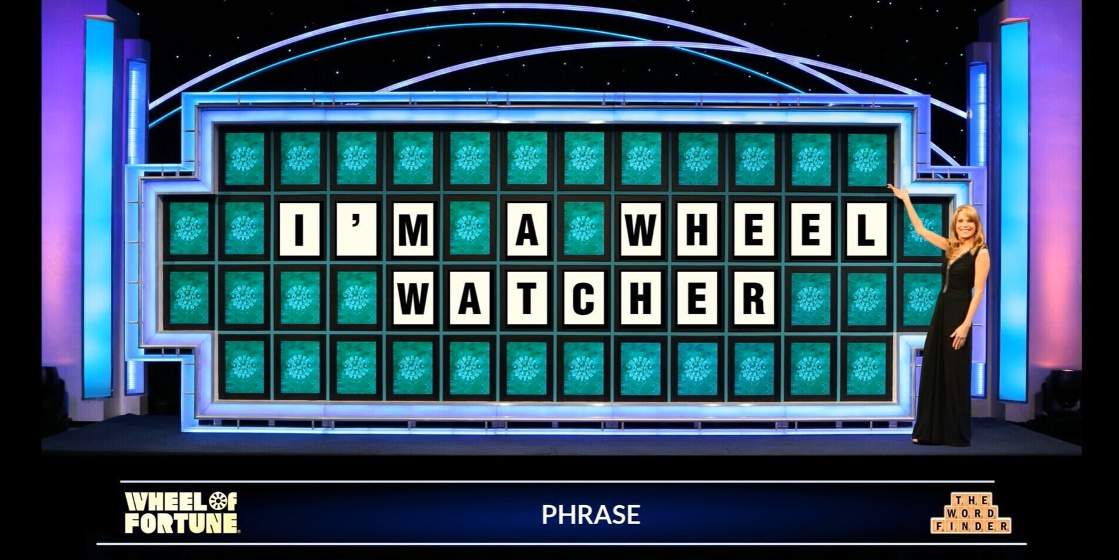

Slide 4
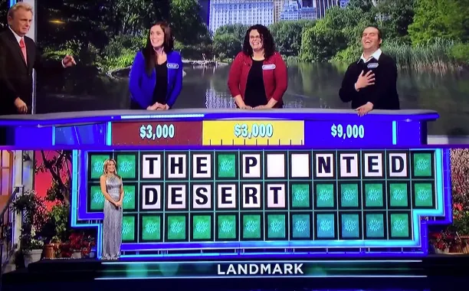

What is
Wheel of Fortune?
A gameshow!
Contestants are given a category and a string of blank tiles representing a hidden answer.
Players take turns guessing letters.
The first player to solve the puzzle wins.

Slide 5

AI IS GREAT.

Slide 6

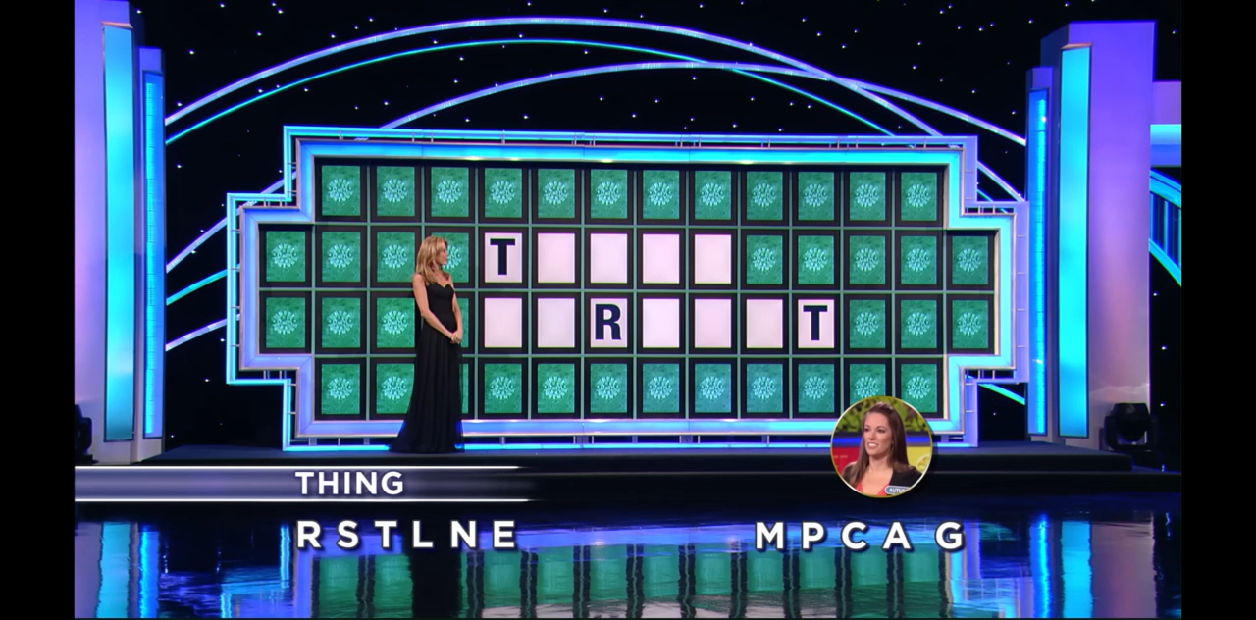

Slide 7
AI IS GREAT.
When it gets it right.

Slide 8
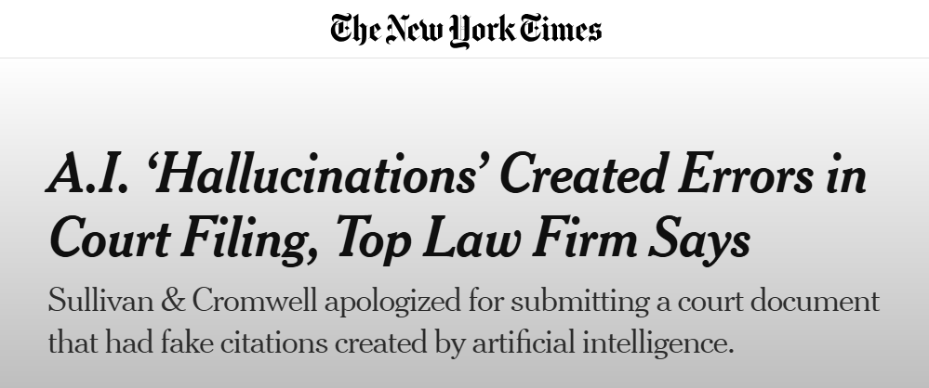
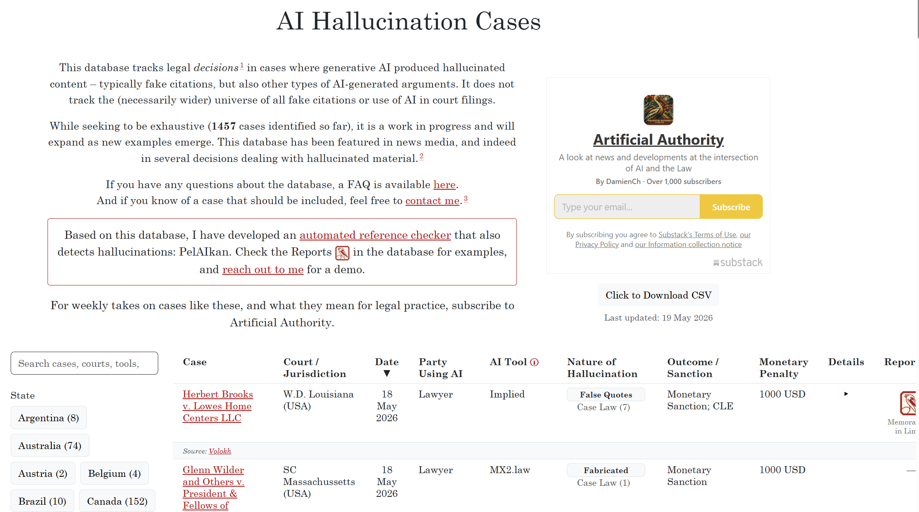
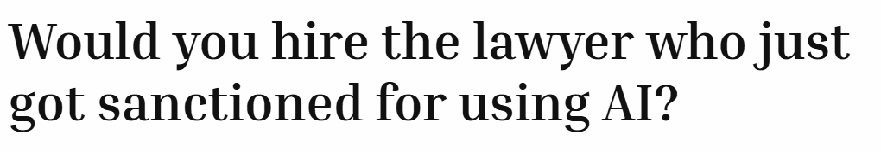
There is a website tracking AI hallucinations in legal!

Slide 9

DO YOU KNOW WHY AI HALLUCINATES?
Could you explain it to someone else?
Notes:
Misunderstanding is leading to poor purchasing decisions and regret. Today I’m going to arm you with some of the knowledge you’ll need to make good decisions.

Slide 10

WHEEL OF FORTUNE SOLVING
The best players use many of the same “tactics” as AI when solving a puzzle:
CONTEXT
STRUCTURE
PROBABILITY
Notes:
Don’t believe me? Let’s go!

Slide 11

Notes:
Encourage you to play along

Slide 12
PERSON
Notes:
As soon as a player sees the category is “Person,” they start eliminating possible solutions. They know the puzzle is NOT “SO MUCH DRAMA” or “WE WERE RIGHT”
That’s exactly what context does in a large language model. It narrows the universe of possible answers before the model generates a single word.
For example, if you prompt an AI tool with: “Draft a Motion to Dismiss in federal court,” it will exclude information about North Dakota requirements in State court. This makes the quality of your output better because you’re filtering out irrelevant possibilities.
Context constrains the universe of possible outputs.

Slide 13
Probably a NOUN
PERSON
Notes:
Now that we’ve narrowed the possible solutions to the category of “Person,” we can look at STRUCTURE more effectively. We know we have 3 words, 2 letters, 4 letters and 5 letters.
Great players have a strong grasp of language structure and leverage that ‘data’ to start narrowing down the function of each word to narrow down the potential solutions on a word-by-word basis. After analyzing the puzzle, they conclude it’s probably a noun phrase.
But right now, the universe of possible answers is still massive.
Now we add another layer of ing. In a noun phrase, the final word is probably the head noun — the core thing being described. Which means this five-letter word is likely a noun describing a person.

Slide 14
Probably an Article
PERSON
Notes:
Now look at the first word. Two letters That strongly suggests an article or determiner. There are not many two-letter options in English.
So we’re already dramatically shrinking the probability space.

Slide 15
Probably modifies Noun
PERSON
Notes:
Which leaves the middle word. If the last word is the noun, then this four-letter word probably modifies that noun. So now we’re not looking for just any word.
We’re looking for a four-letter adjective that naturally appears before a noun describing a person.
That’s exactly what an LLM does. Each new word or letter changes the statistical likelihood of what comes next. The model continuously narrows possible outputs based on the structure and context already on the board.

Slide 16
PERSON
Notes:
Which leaves the middle word. If the last word is the noun, then this four-letter word probably modifies that noun. So now we’re not looking for just any word.
We’re looking for a four-letter adjective that naturally appears before a noun describing a person.
That’s exactly what an LLM does. Each new word or letter changes the statistical likelihood of what comes next. The model continuously narrows possible outputs based on the structure and context already on the board.

Slide 17

AI Models follow similar logic.
+ CONTEXT
+ STRUCTURE
+ PROBABILITY
To predict the next letter, word, or token…

Slide 18

AI
does not understand language
the way
humans do
It is solving your puzzle using the ‘clues’ you give it.

Slide 19
A
N
Y
Probably modifies Noun
C
H
I
L
D
Probably an Article
Probably a NOUN
PERSON
Notes:
Let’ solve the puzzle…
What did you come up with? Let’s see if you were right…

Slide 20


Slide 21
A
N
O
N
L
Y
It does modify Noun
C
H
I
L
D
It is an Article
It is a NOUN
PERSON
Notes:
Lets look at how our analysis fo context + structure + probability worked out.
In short, all of our guesses – our assumptions – were correct.

Slide 22
A
N
U
G
L
Y
It does modify Noun
C
H
I
L
D
It is an Article
It is a NOUN
PERSON
Notes:
Technically, “AN UGLY CHILD” also satisfies every rule we’ve established. It has: the correct structure, the correct number of letters, the correct grammar and it even fits the category “Person.”
But it’s still not the intended solution.
And that’s the mechanism behind many hallucinations. The model is not reasoning about meaning the way humans do. It’s not asking itself, ‘Would a family-oriented game show create a puzzle about an ugly child?’ In the case of AI, it’s not considering, “Is this what the author intended?”
It’s asking: “Does this sequence of words statistically fit the constraints and context I’ve been given?” And sometimes many different answers satisfy those constraints.
That’s why an AI output can look coherent, structured, and completely responsive to your request… and still be wrong.

Slide 23
WHAT AI MISSES
Depends on what the model was trained on.
Even if two phrases statistically satisfy the same structural constraints (like “ugly” and “only”) and appear on the internet with the same frequency before “child,” how do you—the human—know that it’s probably not “ugly child”?
Because you know a game show like Wheel of Fortune is family-friendly, and an “ugly child” would never make it on air.
AI doesn’t.

Slide 24
LEGAL USES SPECIALIZED LANGUAGE
1
2
3
4
Context
Structure
Probability
Output
→
→
→
Legal usage patterns are narrower and more specialized than ordinary language.
Sentence patterns, citations, and procedural conventions are unusual.
The model has less to draw on — its odds shift toward common, not correct.
Plausible-sounding fabrications. Confidently wrong.

Slide 25
So what do we do about it?
DON'T
DO
Avoid AI entirely.
You'll lose ground while everyone else learns it.
Wait for vendors to “fix” hallucinations.
There is no complete fix — probabilistic generation is how the technology works.
Negotiate contractual guarantees against output errors.
Won't hold up; won't make the model accurate.
Use AI more, not less
Build the intuition through reps.
Power users develop a feel for when a model is bluffing.
Use it where it pays off; validate where it doesn’t. Match the tool to the risk.
Treat hallucinations as training data — for you.

Slide 26
If you're a leader, draw the lanes.
GREEN
Safe and encouraged
Identify low risk use cases and AI solutions that can be used without seeking additional approval.
YELLOW
Use with caution
Help your people understand where the danger zones are and what to do when they encounter a potential need. Make it straightforward to submit a request and have it reviewed.
RED
Do not touch
Filings, citations, regulated advice, anything where a fabrication could harm a client or trigger sanctions. Period.

Slide 27
All generative AI hallucinates. Probabilistic systems optimize for plausibility and coherence, not truth.
Context + structure + probability = output. The same toolkit a Wheel of Fortune contestant uses.
Key
Takeaways
Legal language is far from the “average.” That's why niche industries need humans and specialized tooling.
Use it. Often. Out loud. Reps build the instinct that lets you spot the bluff.
At work, set Red / Yellow / Green lanes. Permission with guardrails beats blanket bans every time.

Slide 28
Cheryl Wilson Griffin, VP of Advisory
Cheryl is a pioneer of legal technology, spending about a dozen years launching some of the earliest legal technology teams at firms like Kirkland, Mayer Brown, and King & Spalding. Along the way, she also helped launch two legal tech startups, Opus 2 and Lupl, built and exited a successful consulting practice including work as a strategic advisor for VC and PE firms totaling $500M. Today, as VP of Vendor Advisory at Legal Tech Hub, she leverages her unique 360-degree perspective to advise law firms, investors, and legal tech companies on product strategy, go-to-market execution, and operational excellence.
RECENT SPEAKING TOPICS
  Data Governance, Regulations and Ethics in an AI-Driven World, ILTACON 2024.
  Innovation and Entrepreneurship in Legal, Georgia State Law School.
  Best Practices for Working with Large Language Models, LTH and EY GenAI and Data Enablement Conference.
EDUCATION and CERTIFICATIONS
  MBA from Purdue University with specialization in the Management of Information Systems.
  Professional Certificate in Venture Capital Financing from National Venture Capital Association.
  Certified Information Privacy Professional for Europe (CIPP/E).
  Certified Project Management Professional (PMP).
RELEVANT ENGAGEMENTS
OVERVIEW
Cheryl Wilson Griffin is an experienced legal tech strategist with over 20 years of developing products and services that enable the business and practice of law.
  Advised a 250-lawyer firm to draft its first AI standards and policies, ensuring alignment with regulatory and ethical, and operational requirements.
  Partnered with a leading AI development team to design a bespoke AI-driven analytics platform assessing likelihood of success on contingency matters based on internal knowledge and strategy.
Notes:
My name is Cheryl Wilson Griffin. I won’t bore you with all the great things about me, because all you really want to know is why I’m the person here presenting this to you.
In short, I started working in legal technology in 2002 as a trial consultant helping expert witnesses and partners turn complex case facts into stories juries could understand and relate to.
I’ve spent about half of my career in firms like Kirkland, Mayer Brown, and King & Spalding where I was often as the firm’s first hire around tech innovation for lawyers. In those roles, I worked closely with our lawyers to test and deploy many of the platforms we’ll talk about today – like HighQ, Kira, and Luminance.
I’ve since launched two startups, built and exited a consulting practice of my own, and now work with lawyers and executives across the legal technology space as a VP at Legal Technology Hub.
Finally, I have an MBA from Purdue and recently completed a course on Venture Capital Financing accredited by the National Venture Capital Association and Berkeley Law. [CLICK]

Slide 29
What
Wheel of Fortune
Can Teach Us
About AI
Presented by
Cheryl Wilson Griffin,
VP of Advisory at Legaltech Hub

